Slide 1



BMAA Club Nights
Featured airfield:
Newtownards (EGAD)
Special Guest
Ken Crompton
Ulster Flying Club
Your hosts: Cameron & Cath Spence
Notes:
Introductory slide

Slide 2

This evening
Introduction to BMAA Club Nights
  (2nd Wednesday every month)
Introduction to our special guest
Why should you go to Ards in the first place?
How do you go about it (legal stuff)
What to watch out for
Specific instructions and plate details
Q&A (put in the chat please)
Next month …
Notes:
Any pilot, regardless of experience, should find this course of interest and useful.
As part of the Wings programme, it can be used as part of any of the award levels.

Slide 3
Introducing our special guest
Ken Crompton, Microlight Instructor, Ulster Flying Club
Been flying for how long?
What do you normally fly?
What’s your favourite aircraft
What’s your scariest moment flying?
Notes:
Any pilot, regardless of experience, should find this course of interest and useful.
As part of the Wings programme, it can be used as part of any of the award levels.

Slide 4
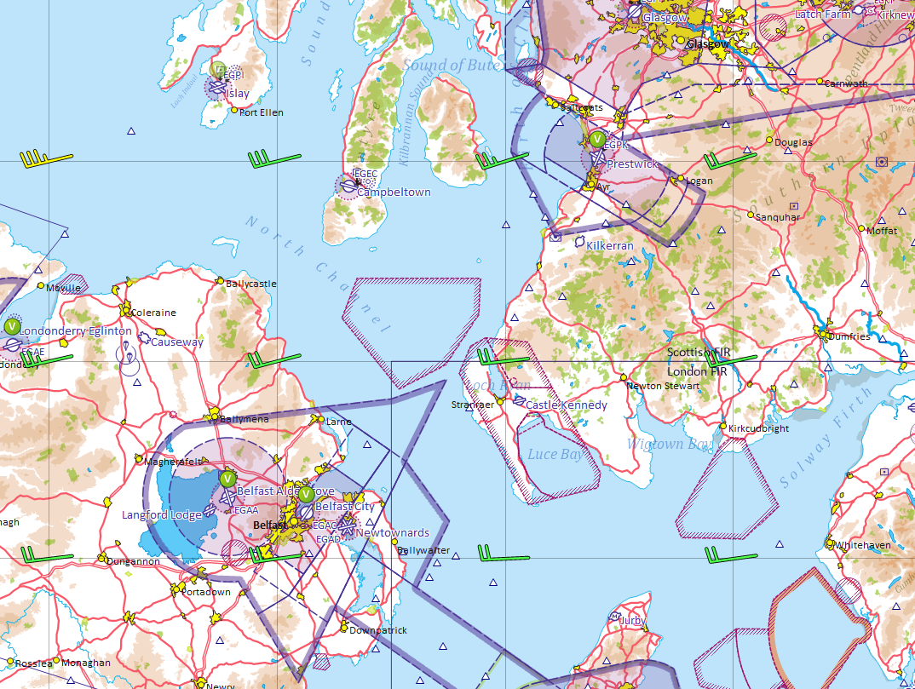
Where is Newtownards anyway?
Notes:
Any pilot, regardless of experience, should find this course of interest and useful.
As part of the Wings programme, it can be used as part of any of the award levels.

Slide 5

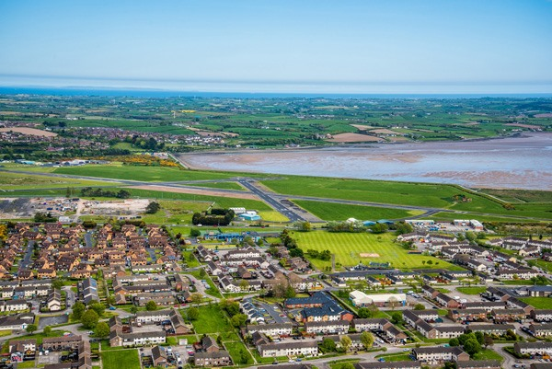
So why visit Ards?
Perfect gateway to/from Ireland (North and South)
Scenery in the local area
Titanic exhibition centre in Belfast
Lots of amazing, challenging airfields (e.g. Kernan/Tandragee)
The craic
Kilkeel Fly-in
C42s to rent
© Martyn Boyd
Notes:
This course can be presented in a modular fashion with essentially 5 sections when the AAIB reports and practice flying are included.
The aim is to introduce additional information such as videos, personal experiences of the presenter and shared experiences of the audience to make this a more interactive course than a simple presentation style delivery.
Examples of useful youtube video clips may be used or alternatives presented (copyright permitting).
The full presentation should take approximately 4 hours to deliver, including a discussion on AAIB reports and Q&A session.
This may be delivered over a number of sessions, hence the modular structure.

Slide 6
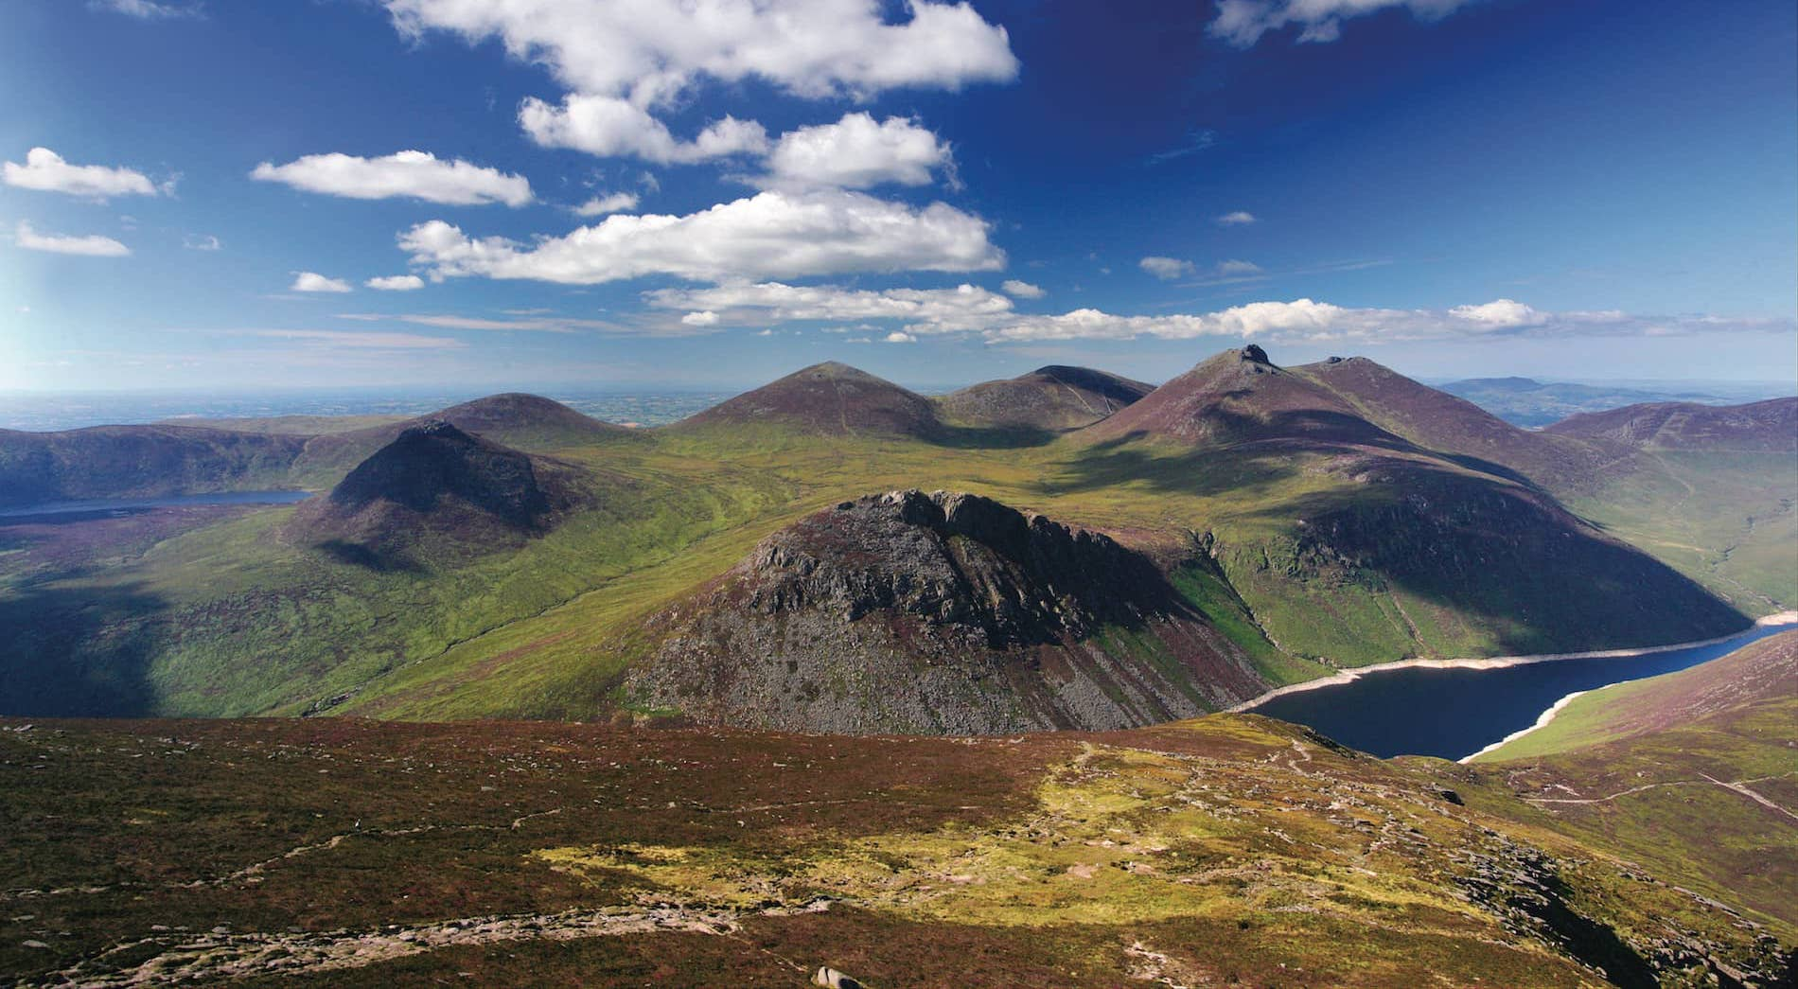
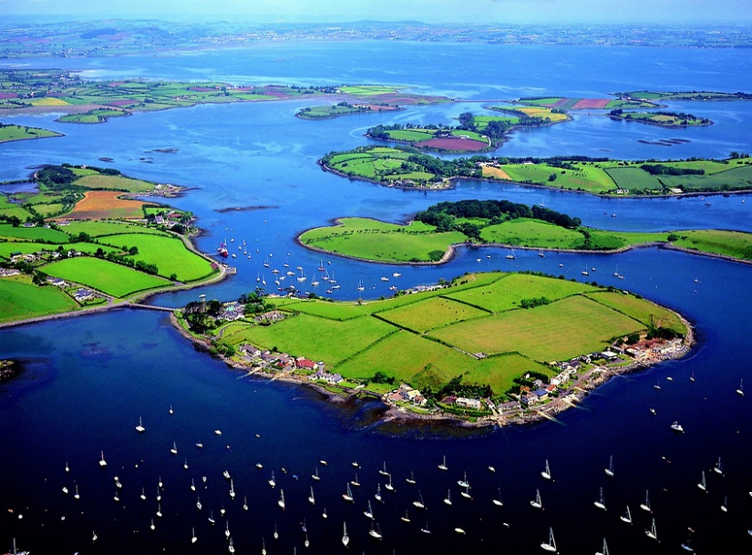


Local Scenery
Notes:
This course can be presented in a modular fashion with essentially 5 sections when the AAIB reports and practice flying are included.
The aim is to introduce additional information such as videos, personal experiences of the presenter and shared experiences of the audience to make this a more interactive course than a simple presentation style delivery.
Examples of useful youtube video clips may be used or alternatives presented (copyright permitting).
The full presentation should take approximately 4 hours to deliver, including a discussion on AAIB reports and Q&A session.
This may be delivered over a number of sessions, hence the modular structure.

Slide 7

Transit to/from NI
Within the United Kingdom of Great Britain and Northern Ireland
The laws are the same, including for
Pilot licences
Medicals
Aircraft
Use Flight Plans both ways between NI and GB. Don’t forget PPR as well.
GARs are not required between NI and GB as this counts as a domestic flight.
(they are between Isle of Man and NI!)
https://www.gov.uk/government/publications/general-aviation-operators-and-pilots-notification-of-flights/general-aviation-report-guidance-accessible#AnnexB , see section 14.3
https://www.psni.police.uk/general-aviation-procedures, relates to Schedule 7 of the Terrorism Act 2000 – it is currently out of date, but being updated (contradicts the UK government guidance on GARs)

Slide 8
Designated Airports in NI
PSNI (Police Service of Northern Ireland) have three designated airports in NI:
Belfast International Airport (EGAA)
Belfast City Airport (EGAC)
City of Derry Airport (EGAE)
If you are not using a designated airport then you must send, via email, details of your planned flight to PSNI (ZPortsRCD@psni.police.uk) plus the relevant GB police force (using contact details given in Annex B above) with at least 12 hours notice, for both arriving and departing flights
Newtownards (EGAD) is a very convenient airport for the crossing as it’s under (but not in) controlled airspace and very informal; Belfast City is a good alternate and takes microlights (see October 2025 edition of MF, pp 28-29)

Slide 9
Routes to/from Northern Ireland
Shortest water crossings (assuming groundspeed of 70 knots) are via:
Call EGAD on 0289 181 3327 prior to setting off – “on the way, ETA is xx:xx”, will give PPR over the phone
Islay (21 nm, 18 minutes)
6500’ from these may give continuous glide-clear
Mull of Kintyre (11 nm, 9 minutes)
Probably limited to 3500’ by Belfast CTA
“chicken route”
Stranraer (19 nm, 16 minutes)
“macho route” – may not see land when you set off
Isle of Man (29 nm, 25 minutes)
Probably limited to 7000’ by London Info

Slide 10
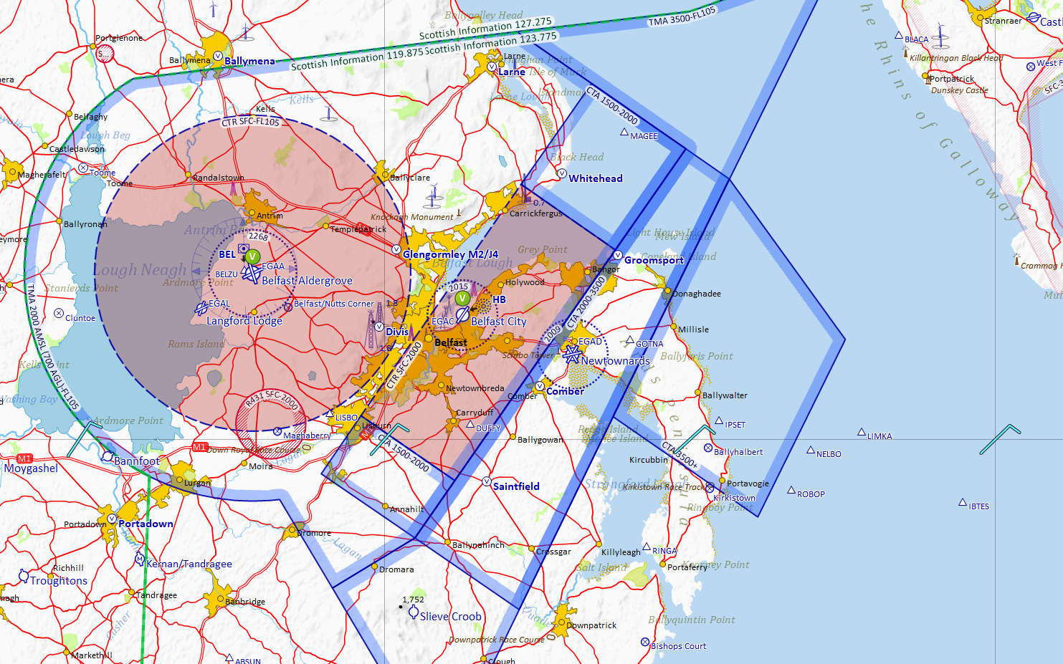
Approaching EGAD
Belfast Approach is 130.850 for coasting in; change to EGAD on 128•305 when approaching EGAD ATZ
Under 1500’ needs no clearance
Only with clearance from Belfast Approach
“chicken route”
Climb to 1800’ for overhead join
CTA starts at 2000’

Slide 11
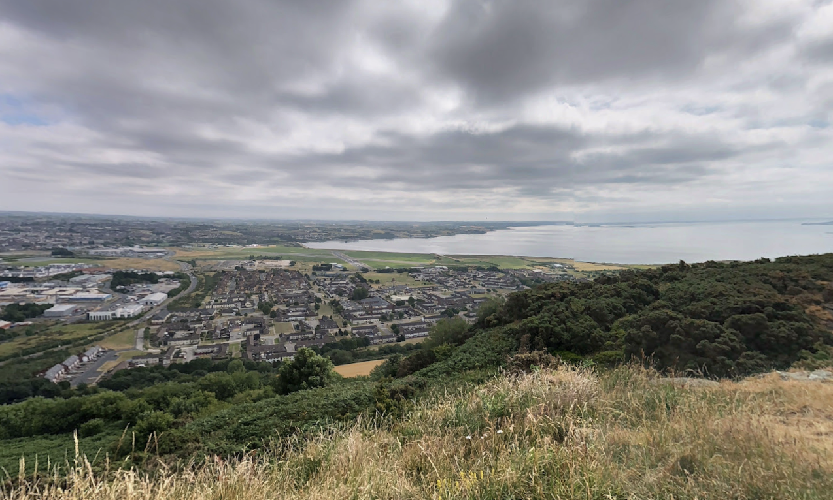
Natural obstacle - Scrabo

Slide 12
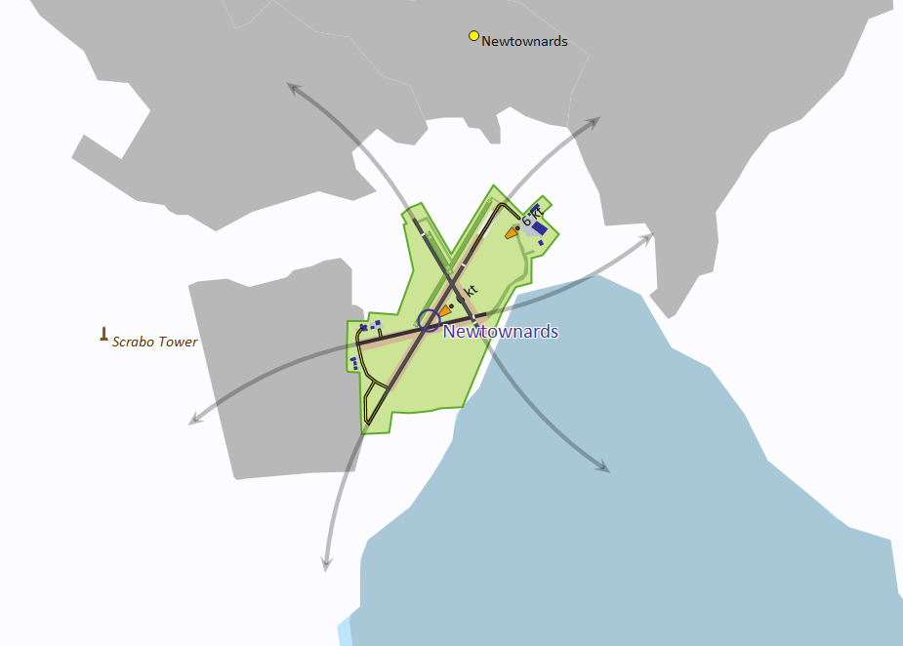
Circuits
15 LH
21 LH
26 LH
No takeoffs or circuits (because of Scrabo)
33 LH
03 RH

Slide 13
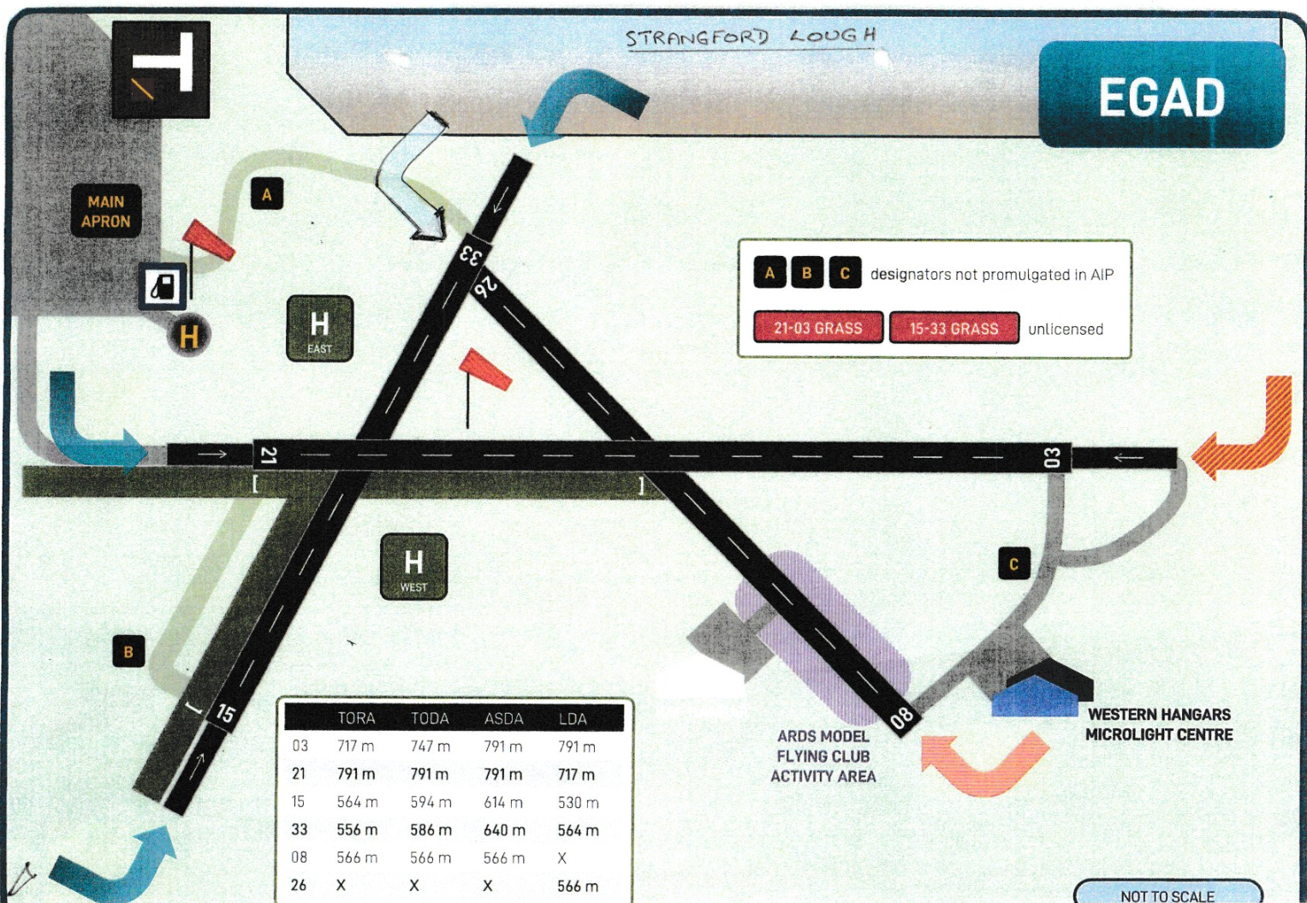
Circuit height depends on downwind speeds:
Above 70 knots – 1000
Under 70 knots – 700’; prefix downwind calls with “Microlight”
Don’t normally take off on 26
08/26 is unlicensed (microlights don’t care)
Don’t normally land on 08
The hill (Scrabo) is this way

Slide 14
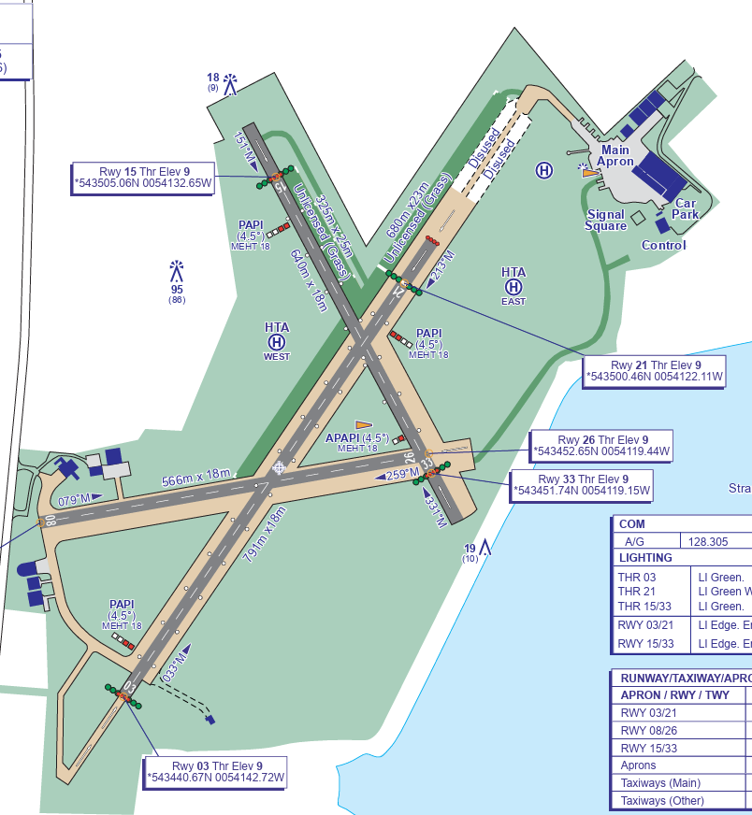
After landing
If airfield busy, vacate runway as quick as possible. Use other runways or grass taxiways (e.g. from threshold of 33)
Come into clubhouse, go to reception. Staff will help with where to put the aircraft.
Normally it’s possible to put your aircraft into a hangar. Members area is there also for visiting pilots, make yourselves at home. Use any club facilities that are there – included in landing fees.
They can organise taxis from reception; can also recommend local B&Bs.

Slide 15
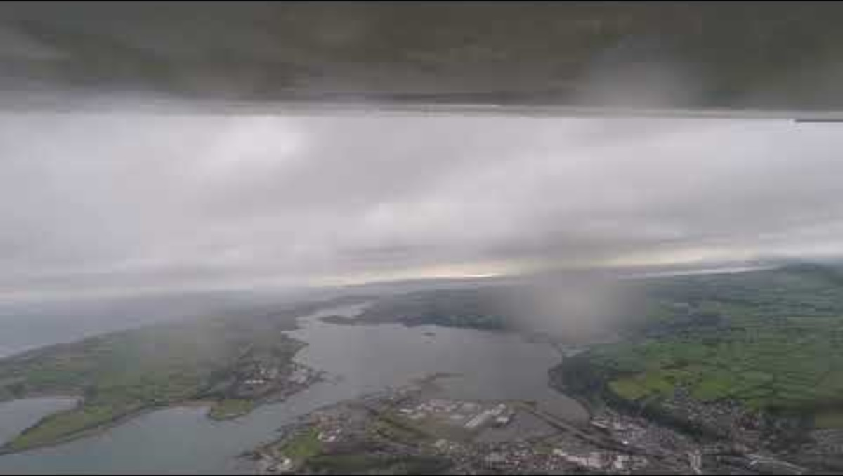
Landing on 33 at EGAD
https://youtu.be/KKeL3Z_-KDU

Slide 16
Questions about Newtownards
?
Notes:
This course can be presented in a modular fashion with essentially 5 sections when the AAIB reports and practice flying are included.
The aim is to introduce additional information such as videos, personal experiences of the presenter and shared experiences of the audience to make this a more interactive course than a simple presentation style delivery.
Examples of useful youtube video clips may be used or alternatives presented (copyright permitting).
The full presentation should take approximately 4 hours to deliver, including a discussion on AAIB reports and Q&A session.
This may be delivered over a number of sessions, hence the modular structure.

Slide 17
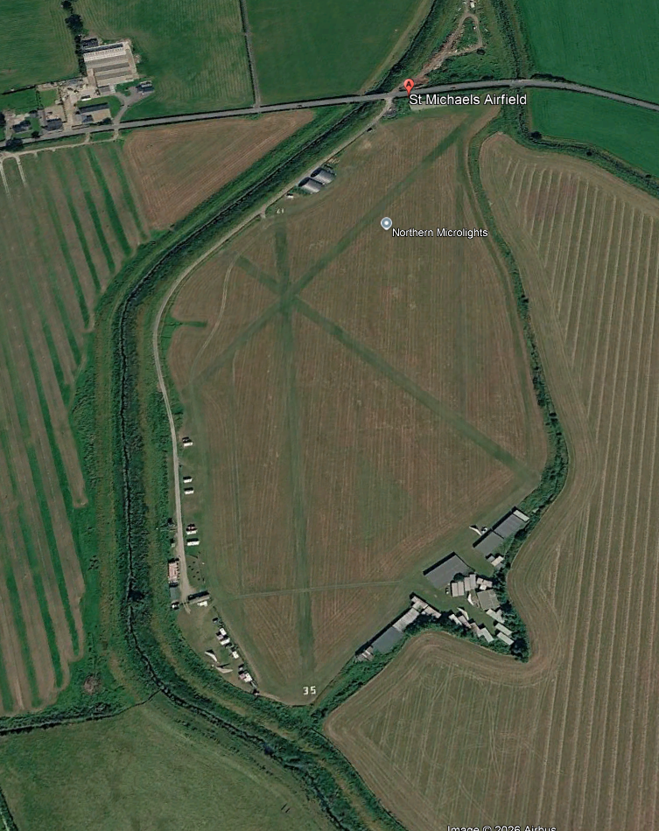
Save the date
Wednesday 10th June, 19:00
Featured airfield: St. Michaels, Lancashire
We want to feature a wide variety of airfields across the UK, as well as other topics; please get in touch with suggestions and offers of help!
Notes:
This course can be presented in a modular fashion with essentially 5 sections when the AAIB reports and practice flying are included.
The aim is to introduce additional information such as videos, personal experiences of the presenter and shared experiences of the audience to make this a more interactive course than a simple presentation style delivery.
Examples of useful youtube video clips may be used or alternatives presented (copyright permitting).
The full presentation should take approximately 4 hours to deliver, including a discussion on AAIB reports and Q&A session.
This may be delivered over a number of sessions, hence the modular structure.

Slide 18
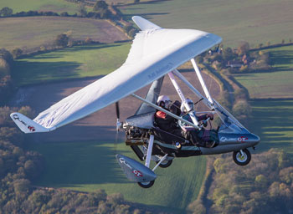
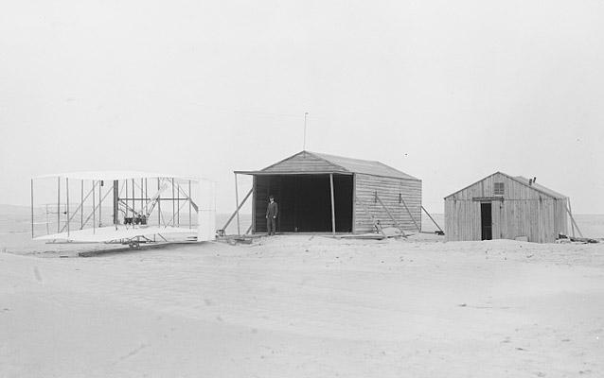
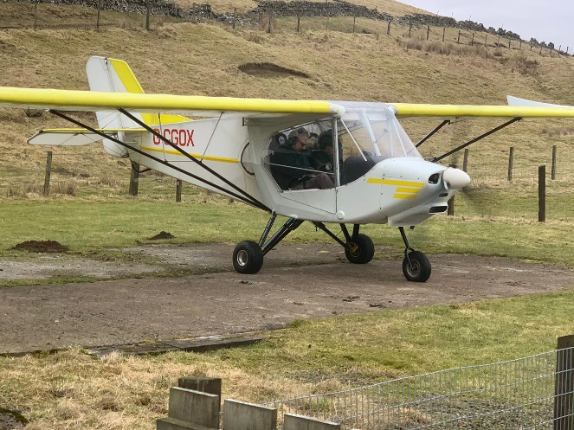
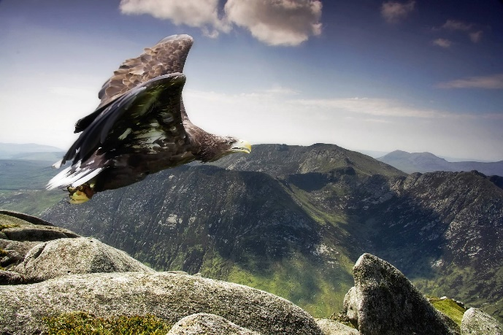
Thank you
Wishing you safe flights
Notes:
Photo by Unknown Author is licensed under CC BY

