Slide 1


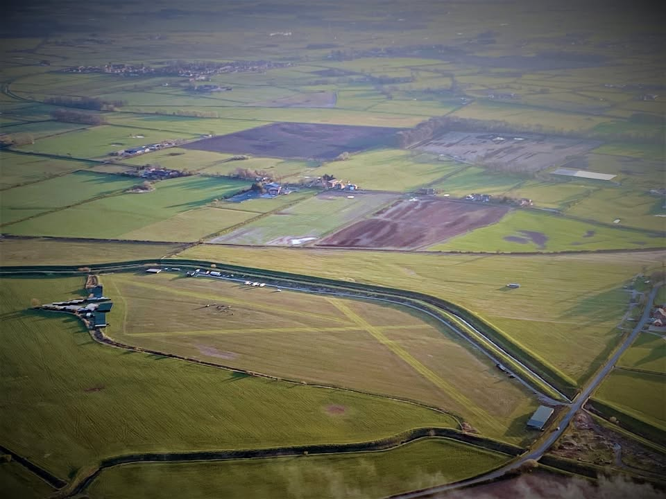
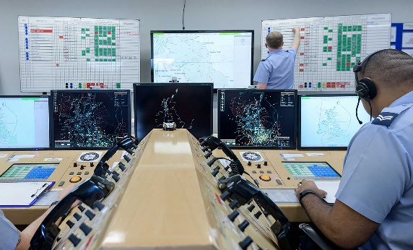
BMAA Club Nights
Featured airfield: St Michaels
Let’s talk about: Distress & Diversion
Special Guests
Paul Turner, St. Michaels Airfield
Flt Lt Blazej Chomik | 78 Sqn | RAF(U) Swanwick
Your hosts: Cameron & Cath Spence
Notes:
Introductory slide

Slide 2

This evening
Introduction to BMAA Club Nights
  (2nd Wednesday every month)
Introduction to our special guests
Why should you go to St. Micks in the first place?
How do you go about it (legal stuff)
What to watch out for
Specific instructions and plate details
What are D&D there for? How can they help us?
How do we talk to them? What would they like from us?
Q&A (put in the chat please)
Next month … Yatesbury + General Aviation Reports
Notes:
Any pilot, regardless of experience, should find this course of interest and useful.
As part of the Wings programme, it can be used as part of any of the award levels.

Slide 3
Introducing our special guest #1
Paul Turner, St. Michaels Airfield
Been flying for how long?
What do you normally fly?
What’s your favourite aircraft
What’s your scariest moment flying?
Notes:
Any pilot, regardless of experience, should find this course of interest and useful.
As part of the Wings programme, it can be used as part of any of the award levels.

Slide 4
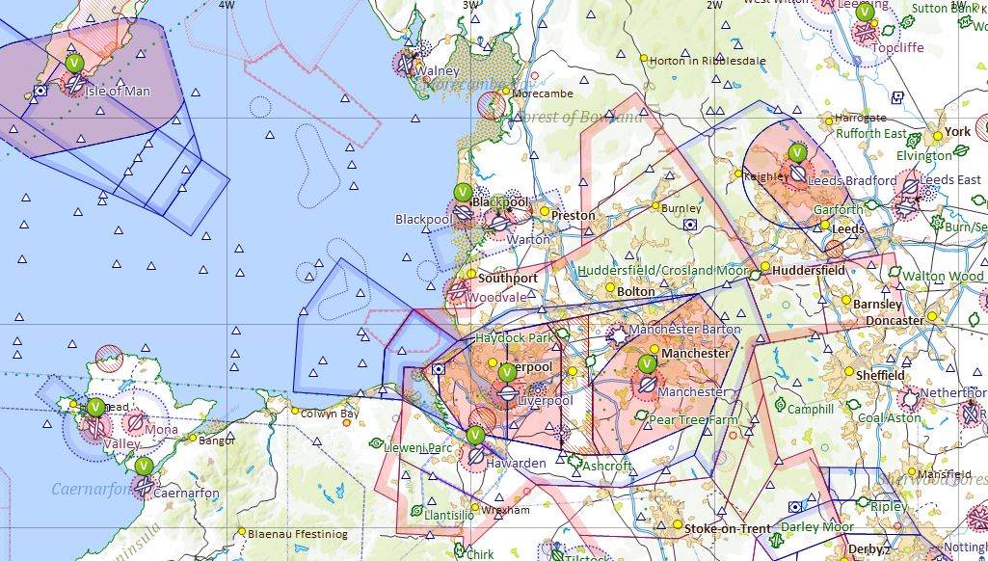
Where is St Michaels Airfield?
St Michaels Airfield
6nm NW of Preston
Alternative Routing
Alternative Routing
North West Transit Corridor
Frequency Monitoring Codes
Manchester 7366 / 118.580 or Liverpool 5060 / 119.855

Slide 5
Arrival into St Micks
Be prepared, if travelling from the South of the UK.
North West Transit Corridor now Class G Airspace, previously known as the Manchester Low Level Route (MLLR) SFC (171’) – 1500’ and approx. 4 miles wide.
Max airspeed 140kts, minimum visibility 5km, use either Manchester or Liverpool QNH
Frequency Monitoring Codes available Manchester 7366 / 118.580 or
Liverpool 5060 / 119.855
Class D Airspace Manchester CTA between 1500’ and 3500’
Class A Airspace TMA above 3500’
Bust this airspace and you will be in trouble.
Entry point coming from the south is just after Ashcroft Airfield, you then have Hawksview, Kenyon Hall and Barton Aerodrome within the NW Transit Corridor.
Warton MATS is your final hurdle, normally closed at the weekend, fly out over Salmesbury and Longridge with the M6 well to your Port side and you are clear of any trouble. 1054’ – 3054’
Warton Listen Squark – 3660 – 129.530 – ATIS 121.730
Blackpool Approach – 119.955 – ATIS 127.205
https://www.caa.co.uk/newsroom/news/uk-civil-aviation-authority-approves-manchester-low-level-route-airspace-change/

Slide 6
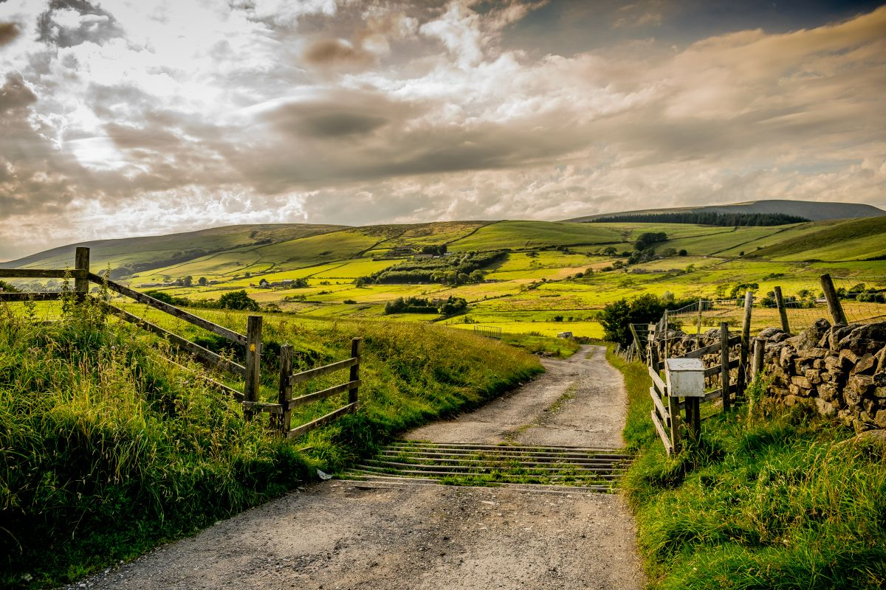
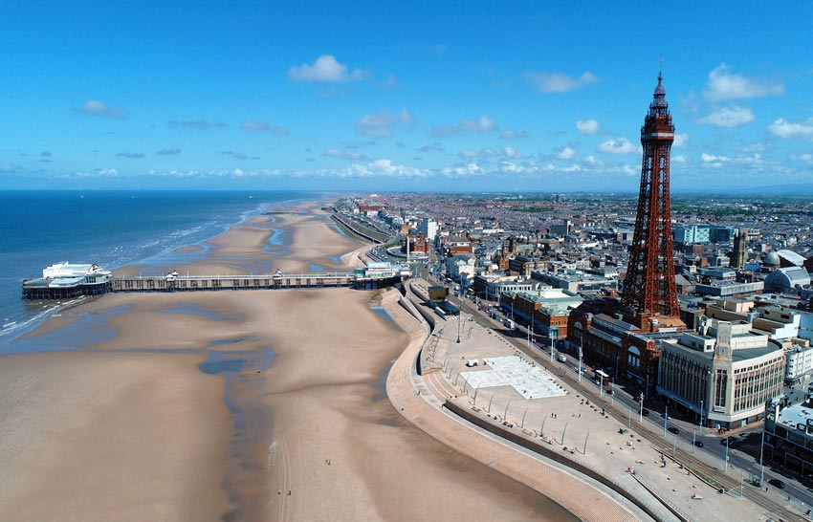


Local Scenery

Slide 7
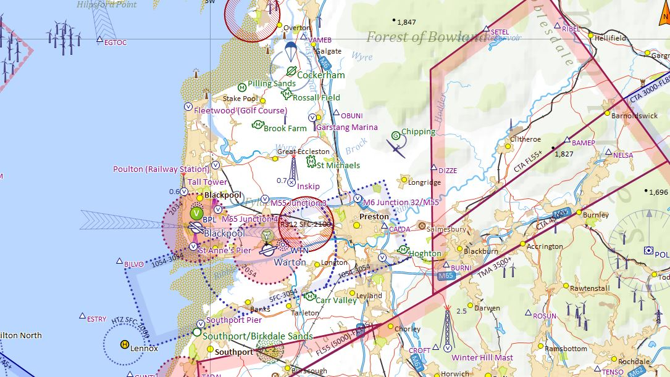
FINAL APPROACH
It all becomes more relaxed the further North you travel
Blind Calls to ‘St Michaels Traffic’
Safetycom 135.480
Overhead Join at 1500’
Circuits at 500’
Blackpool Approach
119.955
ATIS 127.205
Warton MATZ
1054’ – 3054’
Warton Listen Squark
3660 - 129.530
ATIS 121.730

Slide 8
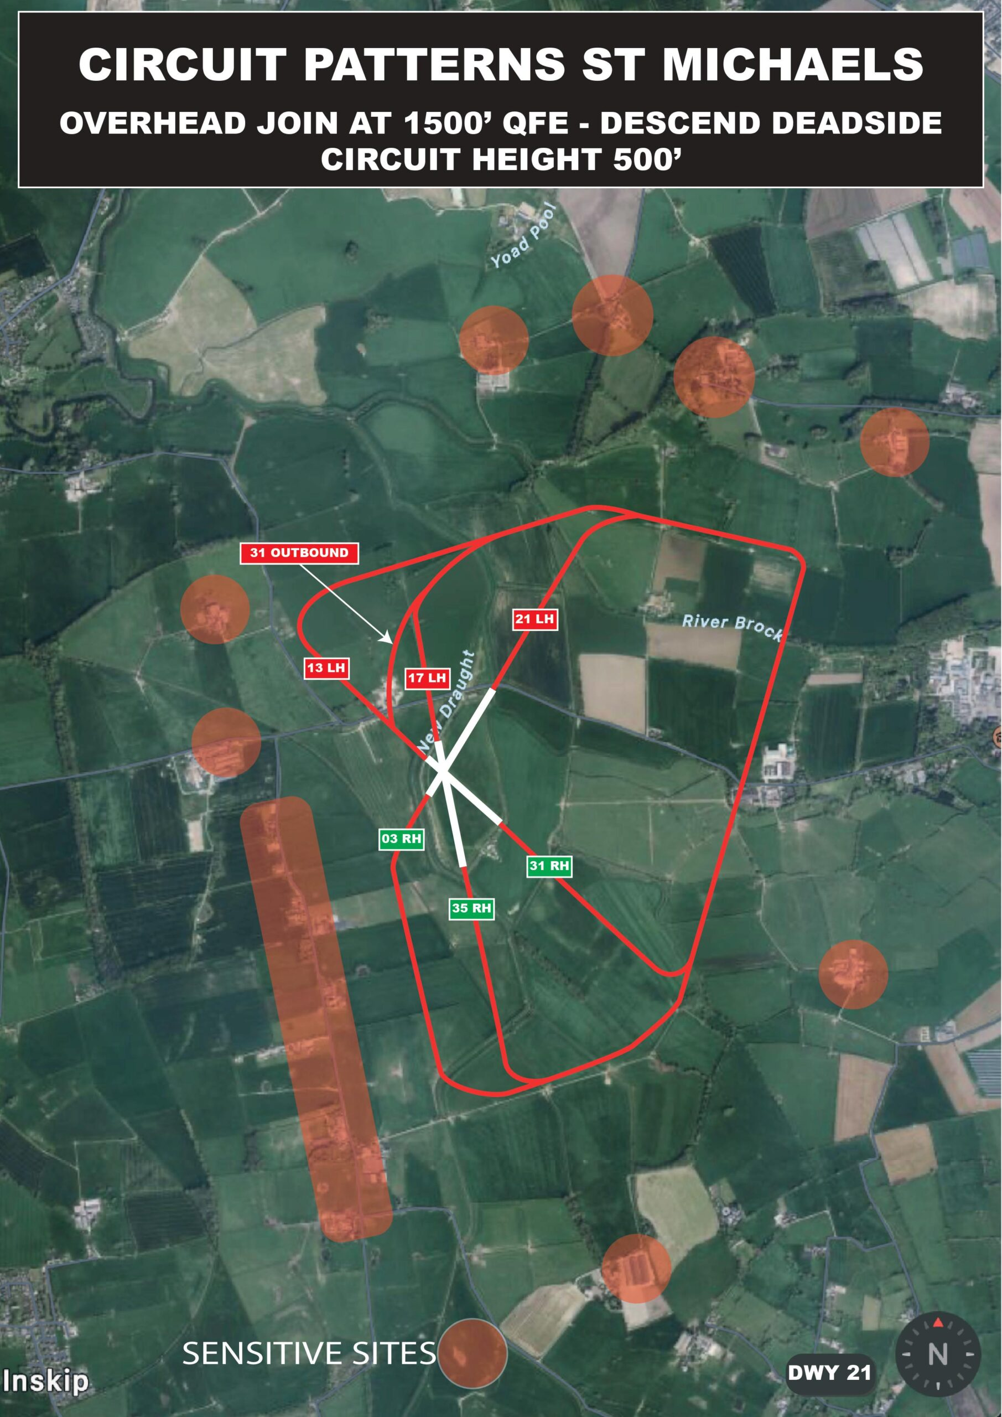
Circuits
Descend Deadside
West Side of the airfield
Yellow Box Area as marked
Windsocks – North and South ends of the airfield.
Avoid overflying local properties (Sensitive Sites as marked)
Runway Numbers on RW 35 / 17
Transit over the airfield to join the circuit to the east and proceed on LH or RH circuit for chosen runway.
St Michaels Airfield is 16’ amsl
Airfield PPR on our website
www.LetsFlyMicrolights.com

Slide 9
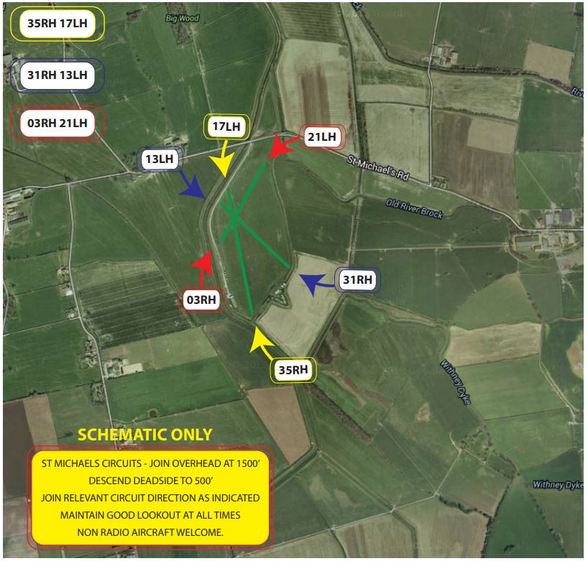
Circuits

Slide 10

Circuits
Position – 6.5nm NW Preston
Lat/Long N53:51.08 W002:47.38
Elevation: 16ft amsl.
No Radio but feel free to make Blind Calls to
'St Michaels Traffic' on Safetycom 135.480
Non-Radio Aircraft Welcome
Runways35RH/17LH Grass - LDA 450m x 12m
31RH/13LH Grass - LDA 365m x 10m
03RH/21LH Grass - LDA 411m x 10m
Arrival
Join overhead 1500’ QFE descend deadside Circuits 500’
35RH/17LH - 31RH/13LH - 03RH/21LH
Notes
Please avoid overflying Sensitive Sites as Marked
Warton Listening Squawk - 3660 - 129.530 - ATIS 121.730
Blackpool Approach - 119.955 - ATIS 127.205

Slide 11
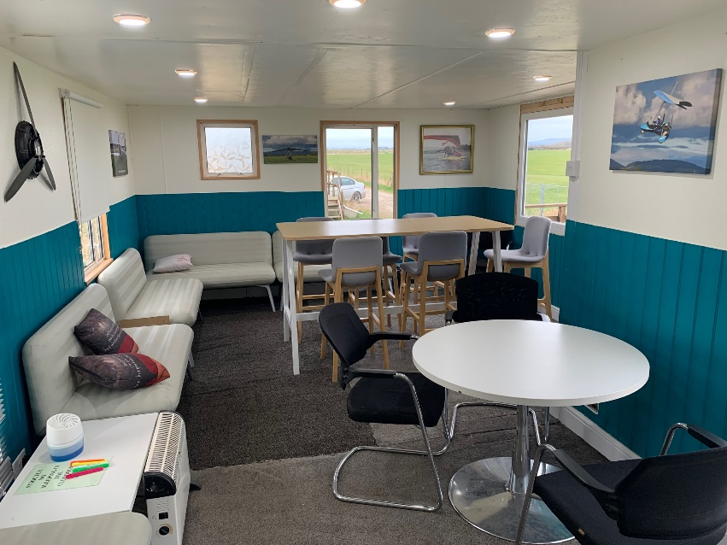
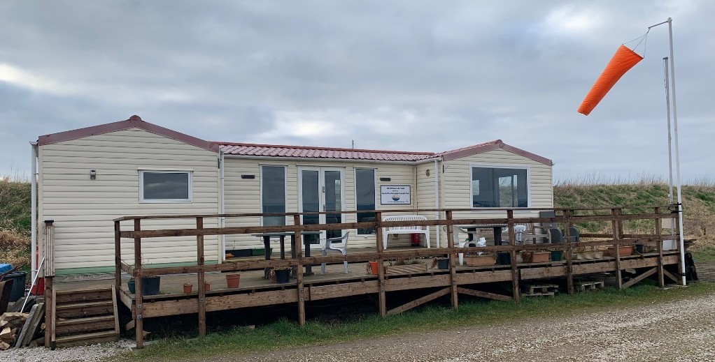
So why visit St Micks?
Perfect stop off point between the North and South of the country
Stunning local scenery, hills, beaches, Lake District and more…
Blackpool Pleasure Beach only 12 miles away
Great Club Atmosphere and Community
Wings & Wheels Weekend & The Flexwing Adventurers Weekend
Always a warm Lancastrian welcome

Slide 12
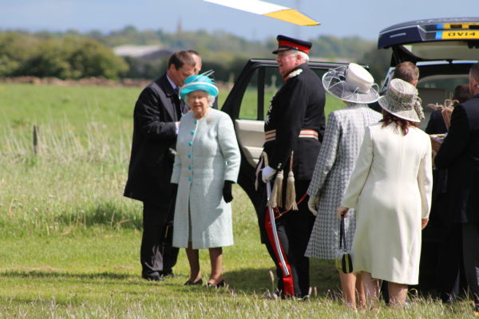
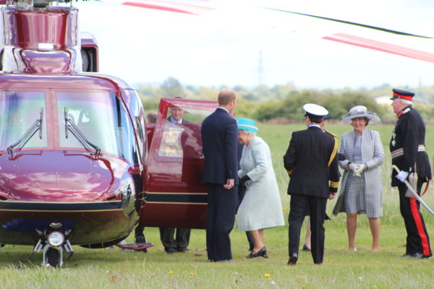
What We Offer
Northern Microlight Flight School – Graham Hobson and Mark Atkinson
The School has been running from St Michaels Airfield since 1985.
North West Microlight Aircraft Club (NWMAC) is one of the longest establish Microlight Clubs in the country. Currently over 110 active members.
Currently around 45 Flexwings, 17 Fixed Wing Microlights and a Gyrocopter.
Her Majesty The Queen visited in May 2015 by helicopter.

Slide 13
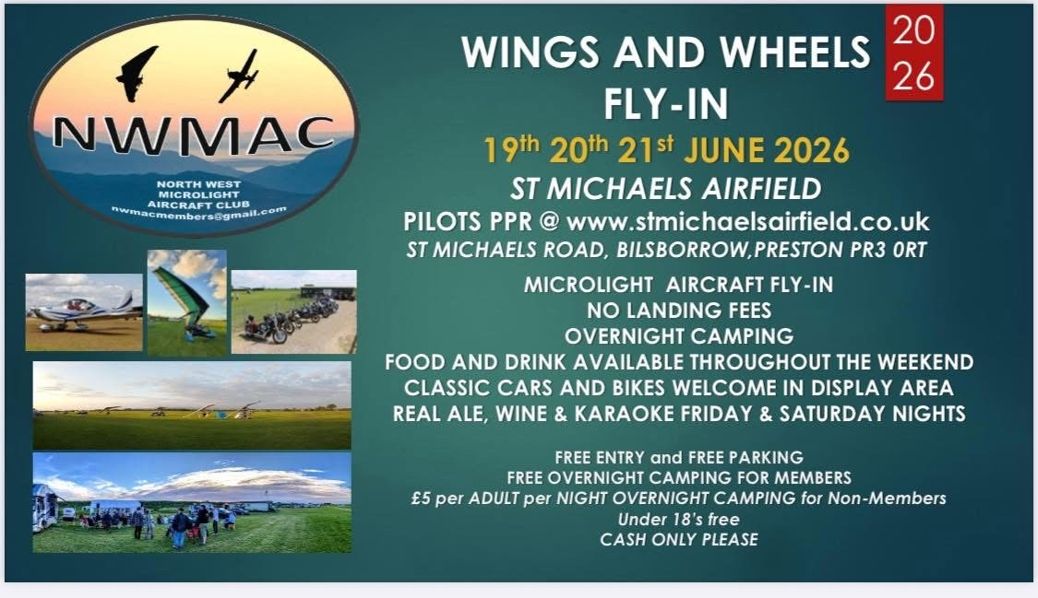

Slide 14


Slide 15

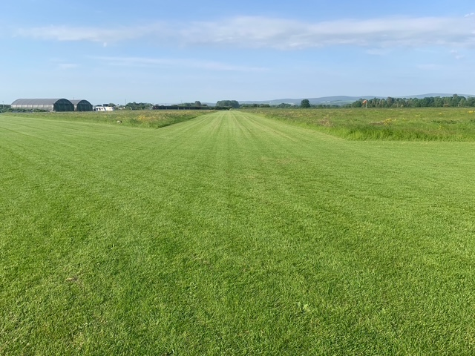
www.AirsideRobotics.co.uk

Slide 16
Quick Flight at St Michaels Airfield
https://youtu.be/Sk59Uq130Pc?si=Qj8rVP7X6juerlRw
Notes:
This course can be presented in a modular fashion with essentially 5 sections when the AAIB reports and practice flying are included.
The aim is to introduce additional information such as videos, personal experiences of the presenter and shared experiences of the audience to make this a more interactive course than a simple presentation style delivery.
Examples of useful youtube video clips may be used or alternatives presented (copyright permitting).
The full presentation should take approximately 4 hours to deliver, including a discussion on AAIB reports and Q&A session.
This may be delivered over a number of sessions, hence the modular structure.

Slide 17
Introducing our special guest #2
Flt Lt Blazej Chomik | 78 Sqn | RAF(U) Swanwick
Been flying for how long?
What do you normally fly?
What’s your favourite aircraft
What’s your scariest moment flying?
Notes:
Any pilot, regardless of experience, should find this course of interest and useful.
As part of the Wings programme, it can be used as part of any of the award levels.

Slide 18
Distress & Diversion
Blaz, this is for your material, looking for 40 minutes plus time for questions.
You can if you prefer use your own slide deck.
Notes:
Any pilot, regardless of experience, should find this course of interest and useful.
As part of the Wings programme, it can be used as part of any of the award levels.

Slide 19
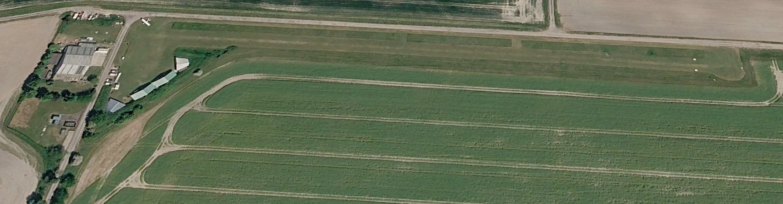
Save the date
Wednesday 8th July, 19:00
Featured airfield: Yatesbury, Wiltshire (hoping for live broadcast)
Also: how to do General Aviation Reports
We want to feature a wide variety of airfields across the UK, as well as other topics; please get in touch with suggestions and offers of help!
Notes:
This course can be presented in a modular fashion with essentially 5 sections when the AAIB reports and practice flying are included.
The aim is to introduce additional information such as videos, personal experiences of the presenter and shared experiences of the audience to make this a more interactive course than a simple presentation style delivery.
Examples of useful youtube video clips may be used or alternatives presented (copyright permitting).
The full presentation should take approximately 4 hours to deliver, including a discussion on AAIB reports and Q&A session.
This may be delivered over a number of sessions, hence the modular structure.

Slide 20
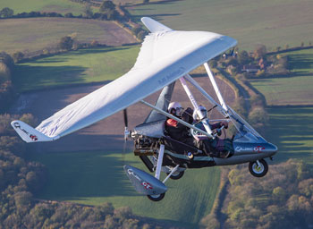
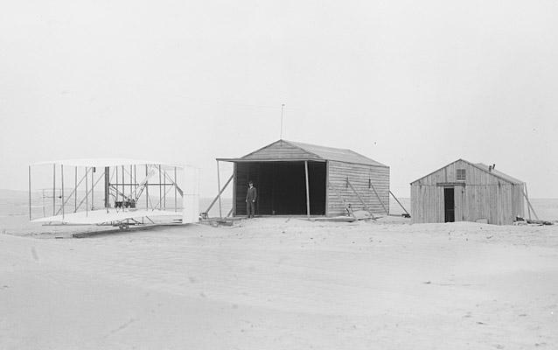
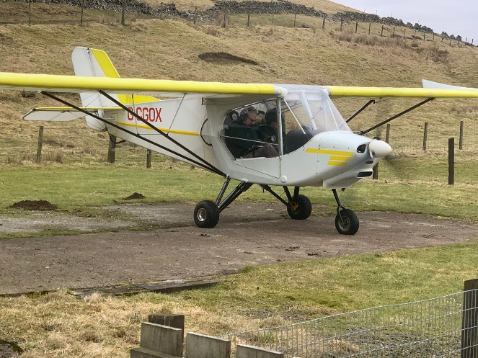
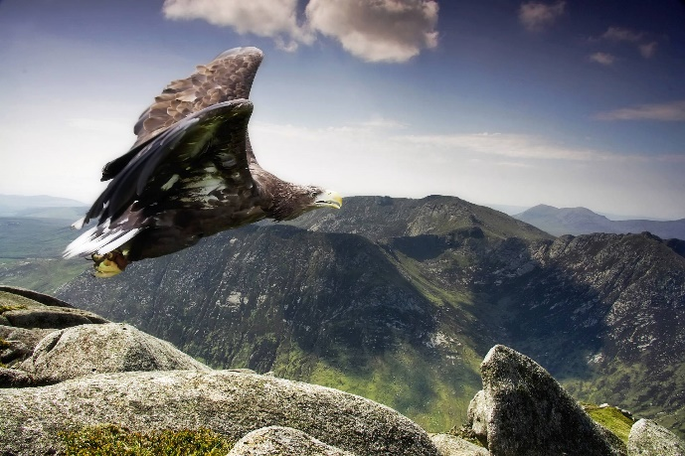
Thank you
Wishing you safe flights
Notes:
Photo by Unknown Author is licensed under CC BY

