Slide 1


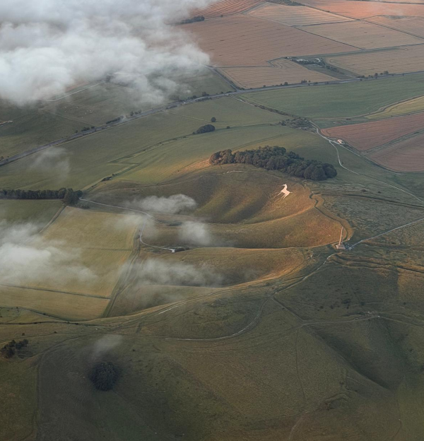
BMAA Club Nights
Featured airfield: Yatesbury
Let’s talk about: General Aviation Reports
Special Guests
Guy Thomas, Debbie Ackroyd
Yatesbury Airfield
Your hosts: Cameron & Cath Spence
Notes:
Introductory slide

Slide 2

This evening
Introduction to BMAA Club Nights
  (2nd Wednesday every month)
Introduction to our special guest #1
Introduction to the airfield
Introduction to our special guest #2
Why should you go to Yatesbury in the first place?
What to watch out for
Specific instructions and plate details
General Aviation Reports (time permitting)
Q&A (put in the chat please)
Next month …
Notes:
Any pilot, regardless of experience, should find this course of interest and useful.
As part of the Wings programme, it can be used as part of any of the award levels.

Slide 3
Introducing our special guest #1
Debbie Ackroyd, Yatesbury Airfield
Been flying for how long?
What do you normally fly?
What’s your favourite aircraft
What’s your scariest moment flying?
Tell us a bit about Yatesbury – its past, present and future
Notes:
Any pilot, regardless of experience, should find this course of interest and useful.
As part of the Wings programme, it can be used as part of any of the award levels.

Slide 4
Introducing our special guest #1
Guy Thomas, Yatesbury Airfield
Been flying for how long?
What do you normally fly?
What’s your favourite aircraft
What’s your scariest moment flying?
Notes:
Any pilot, regardless of experience, should find this course of interest and useful.
As part of the Wings programme, it can be used as part of any of the award levels.

Slide 5
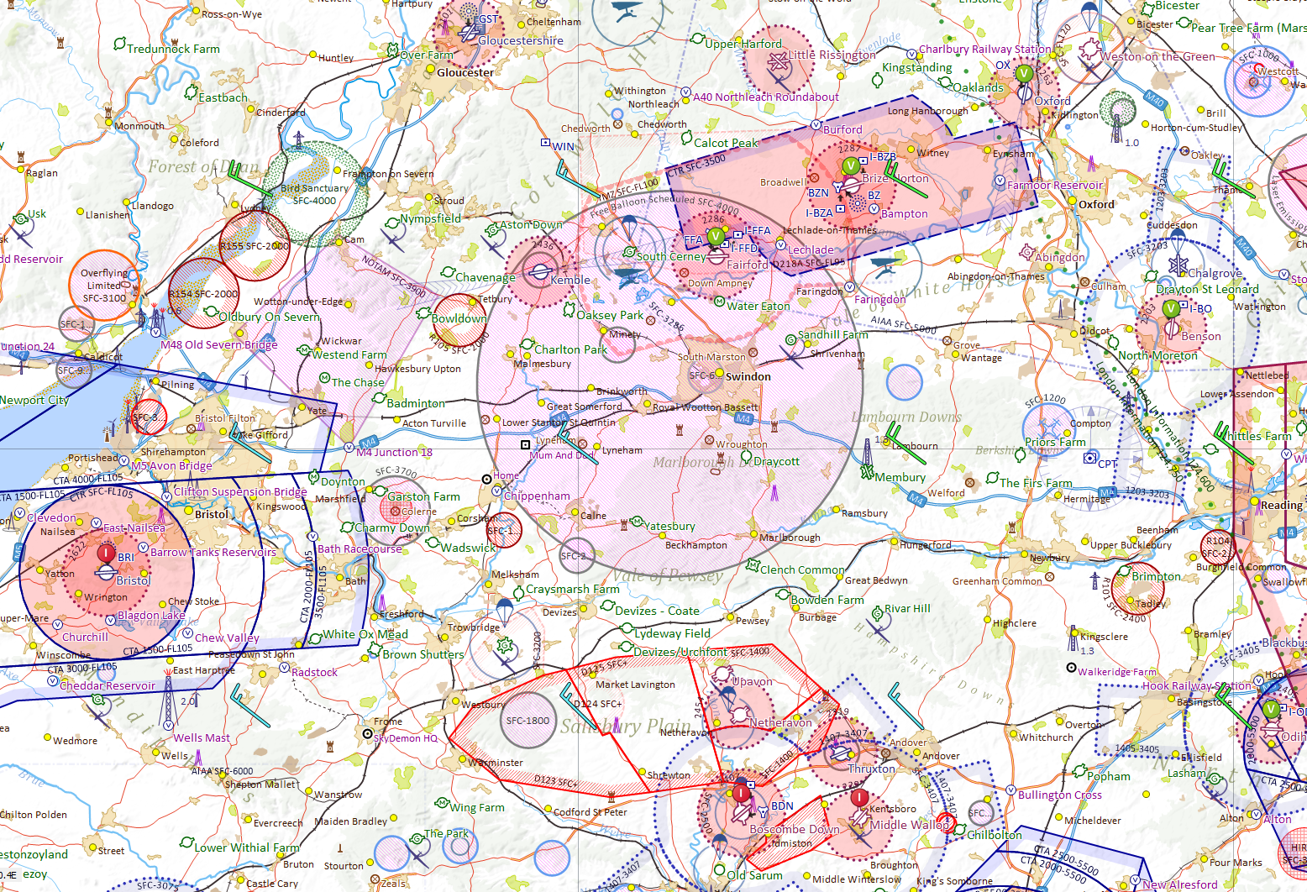
Where is Yatesbury?
HERE!
SafetyCom 135.480

Slide 6
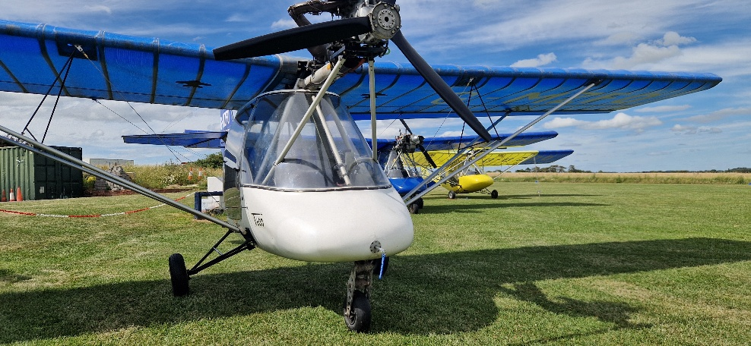
So why visit Yatesbury?
Surrounded by breathtaking scenery
A stone’s throw away from Avebury Stone Circle, which is far more interesting than Stone Henge
Great Club Atmosphere and Community
A stones throw away from Silbury Hill, the tallest prehistoric man-made mound in Europe and World Heritage Site.
Always a warm welcome
The home of Thruster 001

Slide 7
What We Offer
Flight school offering training and C42 rental
400m grass runway which is lovingly cared for, mowed often and as smooth as silk to land on (pilot skill depending).
Frequent club events and fly-ins, recently hosted a Thruster Muster and was grateful to be chosen again to host the Severn Valley Microlight Club (we must be doing something right!)
Petrol if needed, but please let us know when you call for PPR so we can ensure it’s ready.
A warm welcome, always.

Slide 8
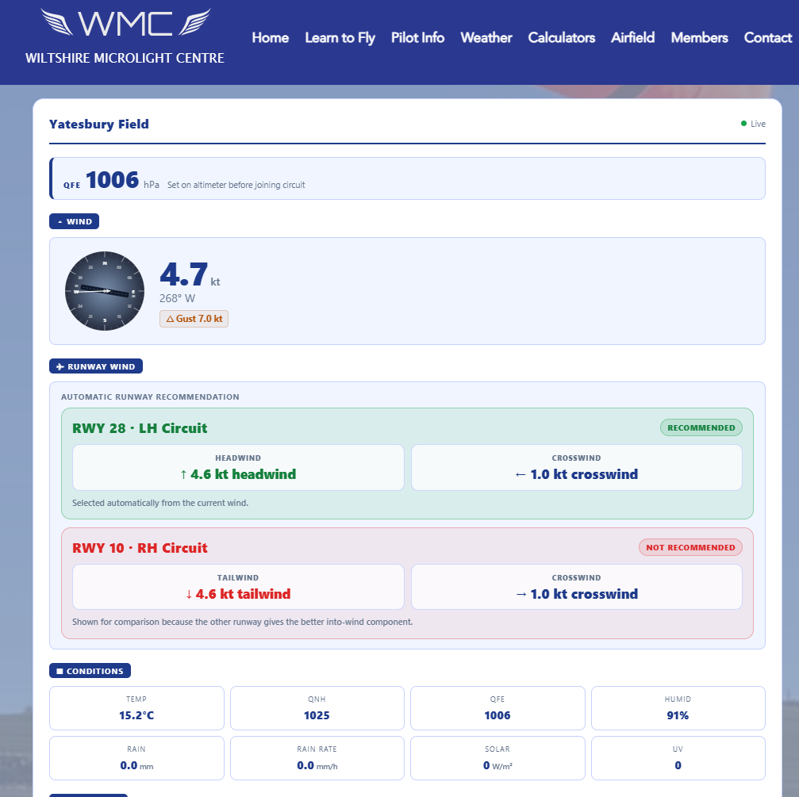
Arrival into Yatesbury
Couldn’t be simpler!
No immediate airspace to be aware of or concerned about
For en-route services use Brize Radar (124.280) or Farnborough Radar (125.250) or London Information.
Make a call on Safety Com when 5 miles from Yatesbury to let us know you’re inbound.
Check out our live weather station on the website!
http://www.wiltsmicrolights.com

Slide 9
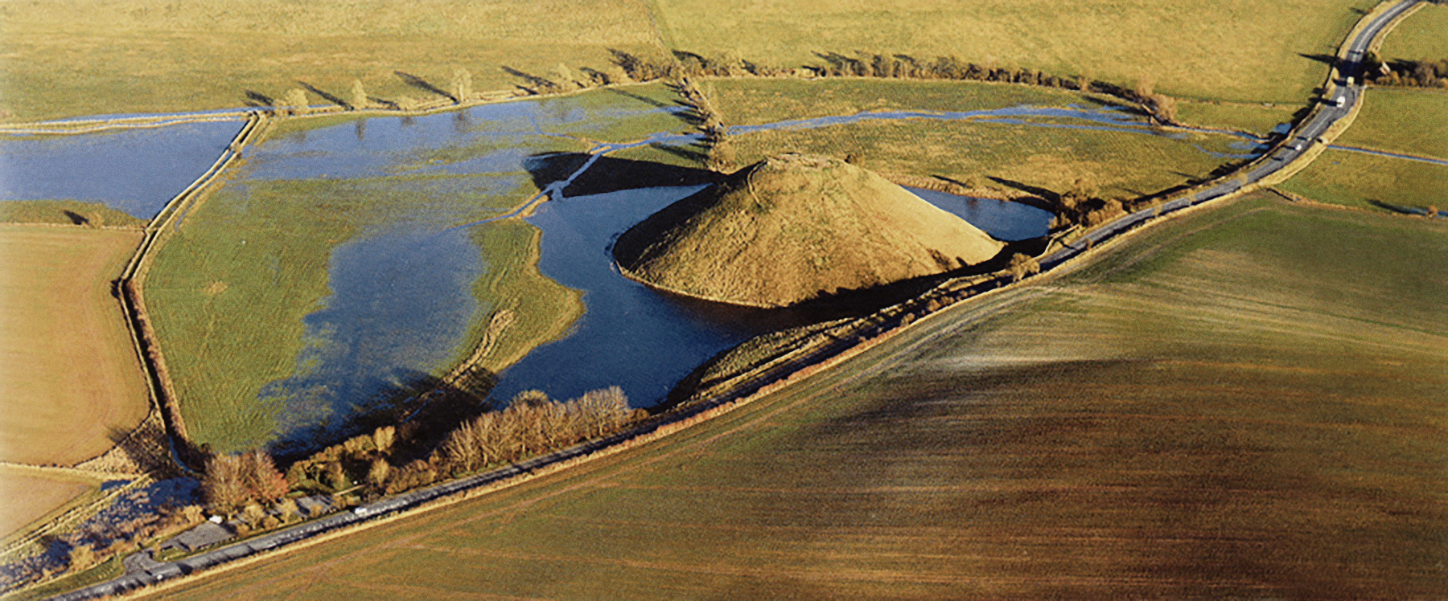
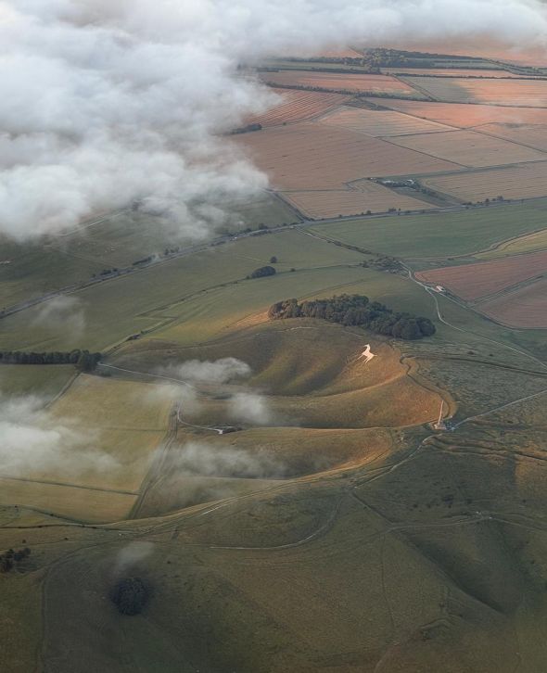
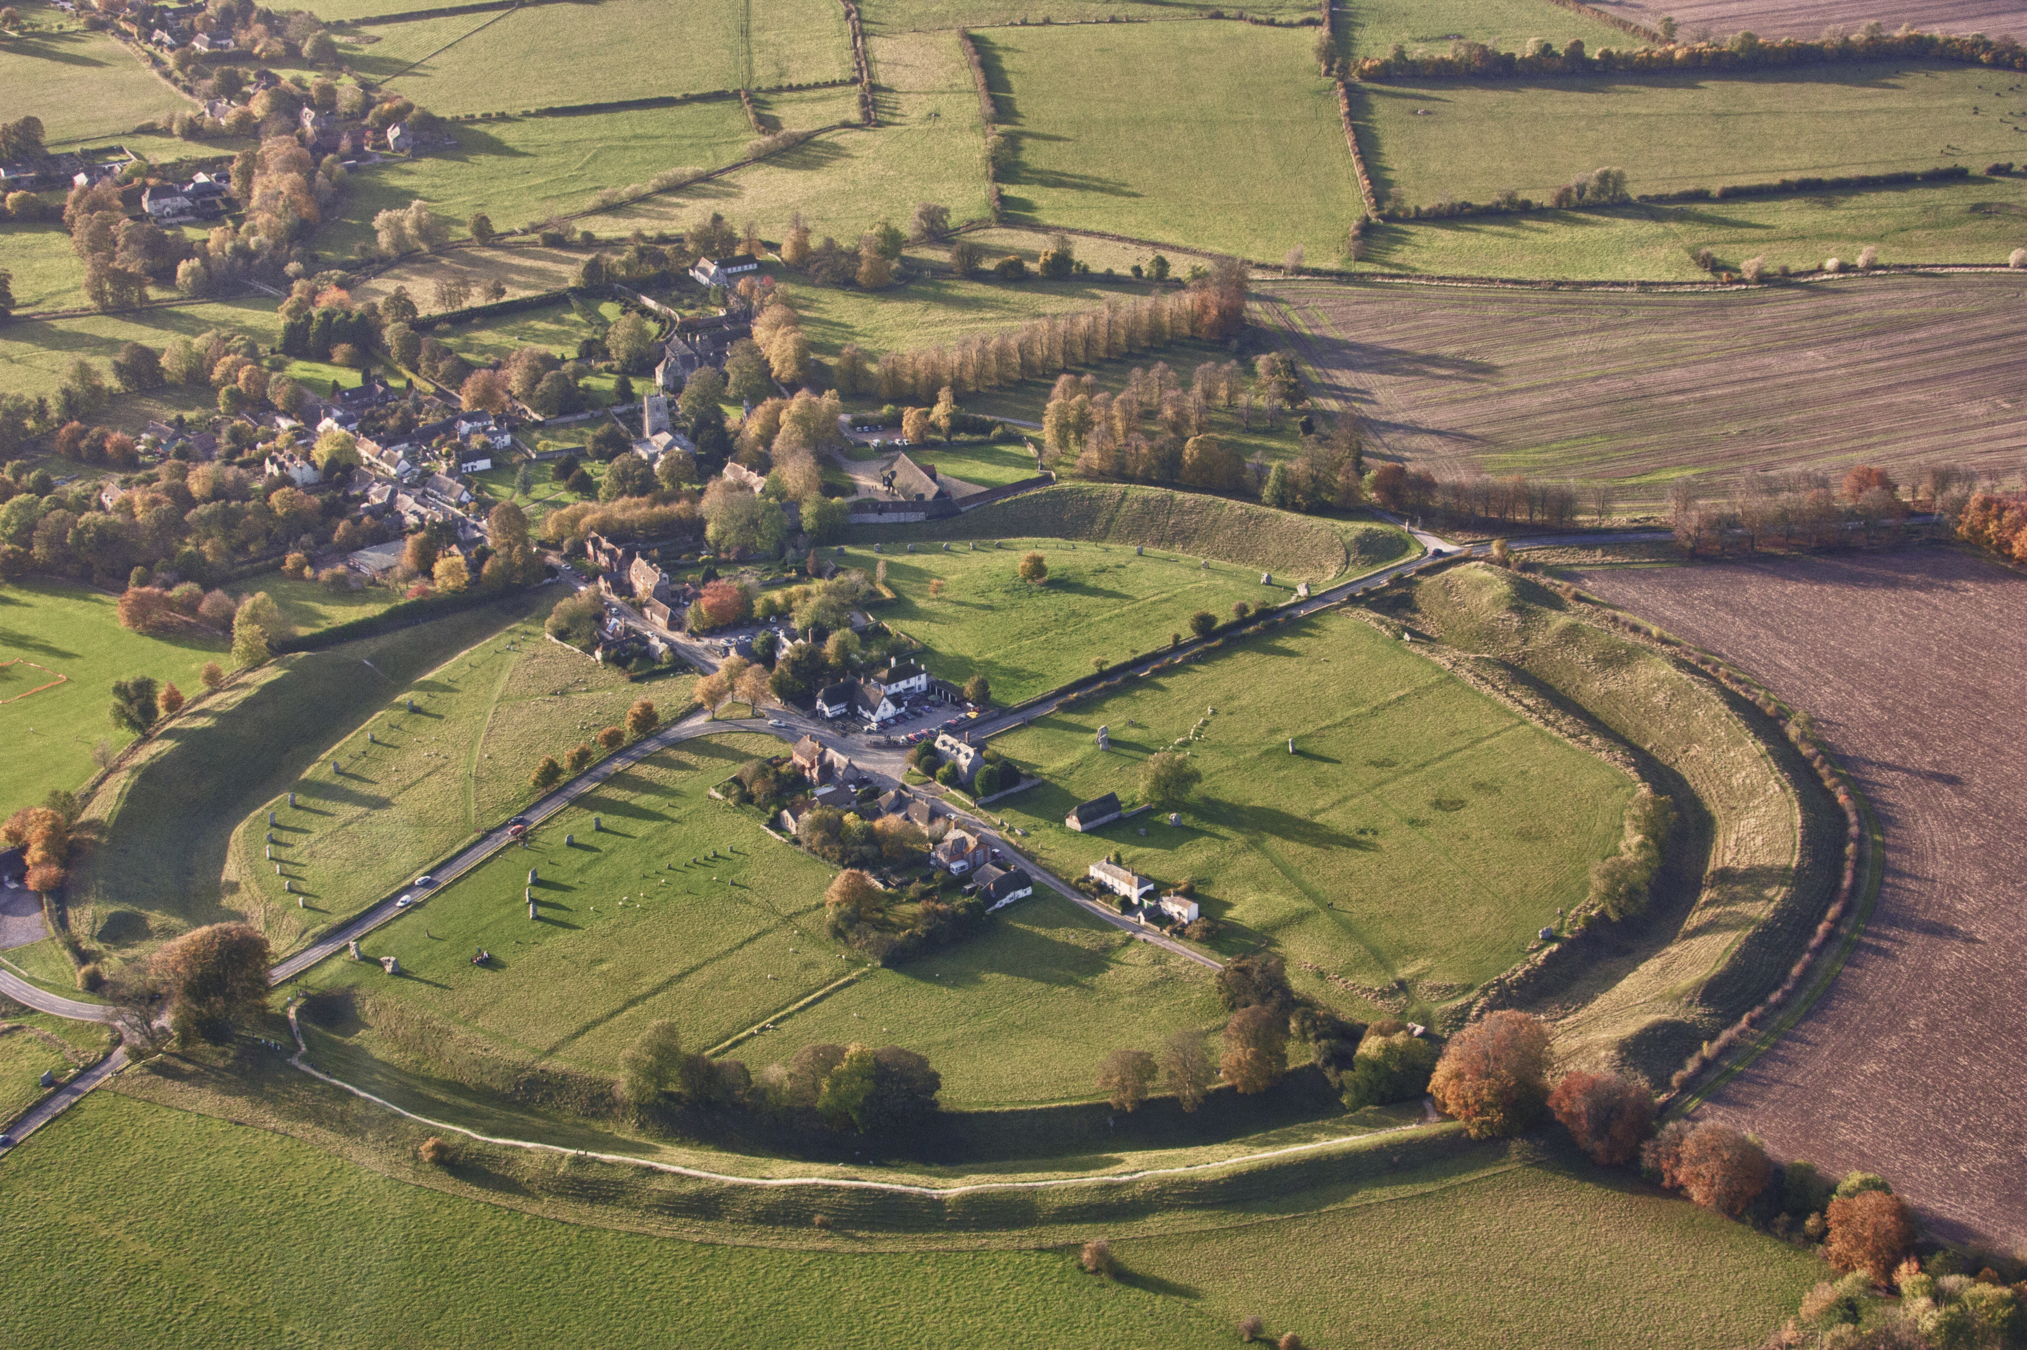
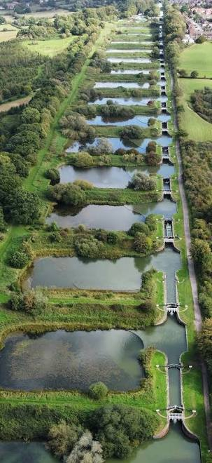

Local Scenery

Slide 10
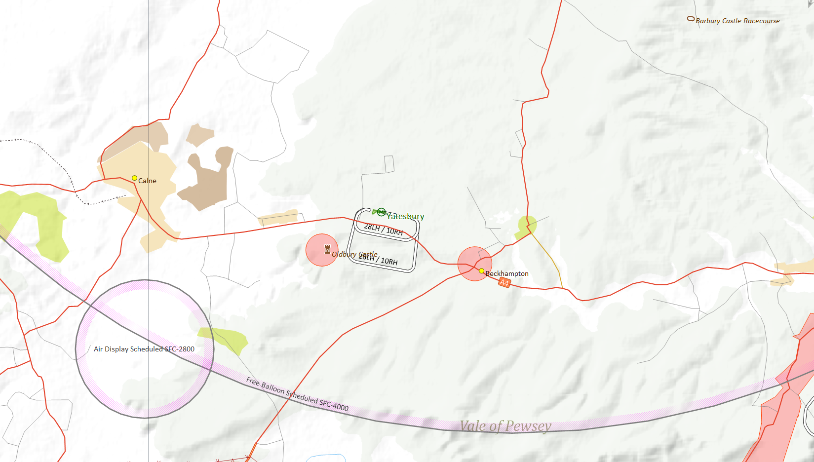
FINAL APPROACH
No overhead joins
Please join from the south
Caution noise abatement areas
AVOID
Blind calls on Safety Com
“Yatesbury Traffic”

Slide 11
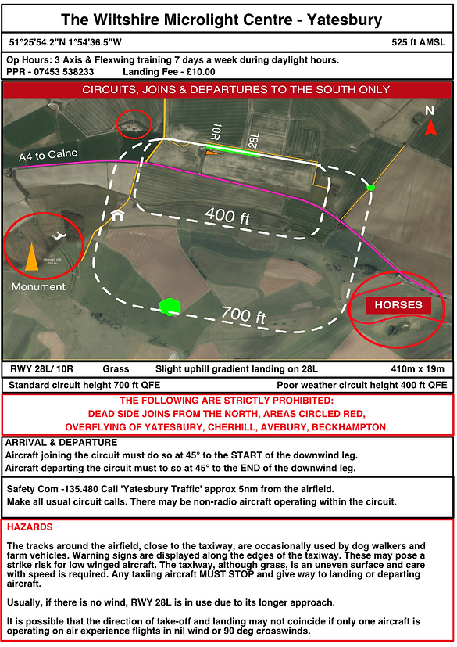
Circuits
All joins and departures to the south
Joining to be done at 45deg to the start of the downwind leg
Departing to be done at 45deg to the end of the downwind leg
Please get PPR via telephone, number on website.
www.wiltsmicrolights.com

Slide 12
General Aviation Reports
Notes:
Any pilot, regardless of experience, should find this course of interest and useful.
As part of the Wings programme, it can be used as part of any of the award levels.

Slide 13
Any questions?
Either about Yatesbury or General Aviation Reports
Notes:
Any pilot, regardless of experience, should find this course of interest and useful.
As part of the Wings programme, it can be used as part of any of the award levels.

Slide 14
Save the date
Wednesday 12th August, 19:00
We’re still looking for another airfield – any offers?
We want to feature a wide variety of airfields across the UK, as well as other topics; please get in touch with suggestions and offers of help!
Notes:
This course can be presented in a modular fashion with essentially 5 sections when the AAIB reports and practice flying are included.
The aim is to introduce additional information such as videos, personal experiences of the presenter and shared experiences of the audience to make this a more interactive course than a simple presentation style delivery.
Examples of useful youtube video clips may be used or alternatives presented (copyright permitting).
The full presentation should take approximately 4 hours to deliver, including a discussion on AAIB reports and Q&A session.
This may be delivered over a number of sessions, hence the modular structure.

Slide 15
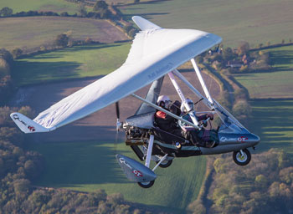
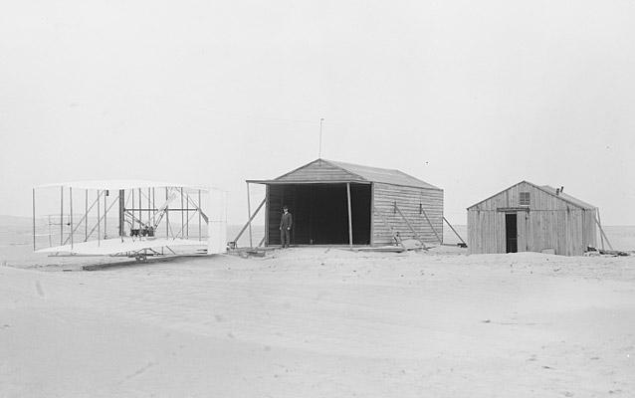
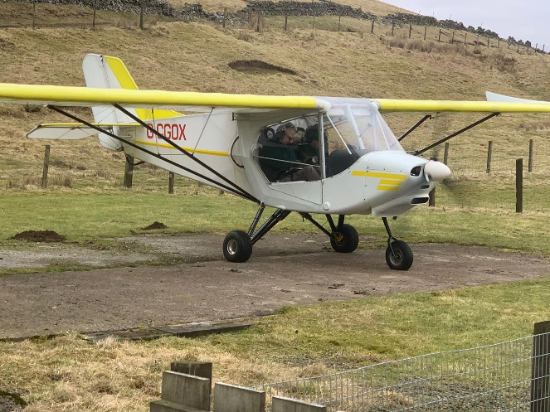
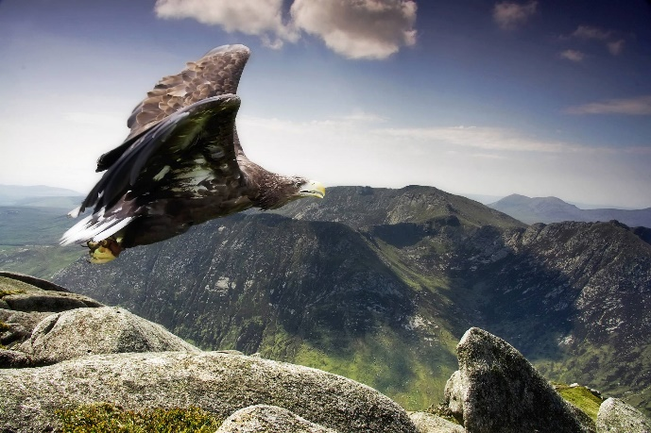
Thank you
Wishing you safe flights
Notes:
Photo by Unknown Author is licensed under CC BY

