Slide 1


Wings Navigation Exercises
Tips and Tricks
Notes:
Introductory slide

Slide 2
Wings Navigation Exercises
Plan accurately • Fly safely • Record evidence • Learn from actuals
PLAN → FLY → IMPROVE
B
BRONZE
S
SILVER
G
GOLD
D
DIAMOND
ACCURACY
≥ 100 nm • ≥ 1 land-away • ≤ 1 day
≥ 200 nm • ≥ 2 land-aways • ≤ 2 days
≥ 300 nm • ≥ 3 land-aways • ≤ 3 days
≥ 500 nm • ≥ 5 land-aways • ≤ 5 days
Total fuel burn
and journey time
within ±20%
1
CHOOSE THE CHALLENGE
2
BUILD THE ROUTE
3
RUN THE NUMBERS
4
RECORD THE PLAN
Select an award level and overall distance.
Add a waypoint at least 20 nm after take-off.
Generate a PLOG for each individual flight.
Enter planned times, durations and waypoint.
Choose a route you would be happy to fly.
Use features that are easy to identify.
Transfer distances and times to a spreadsheet.
Record planned total fuel and distance.
Identify possible land-away aerodromes.
Add planned altitude for every leg.
Estimate hourly fuel burn from PoH or experience.
Give the plan to an observer or submit it.
5
PREPARE & FLY SAFELY
6
CAPTURE ACTUALS
7
COMPARE & LEARN
Complete normal pre-flight planning and checks.
Record leaving and joining circuit times.
Compare planned journey time with actual time.
Carry plenty of fuel and record start quantity.
Record each specified waypoint time.
Compare planned fuel burn with actual fuel.
Safety always takes priority over the exercise.
Log en-route fuel purchases and final fuel.
Adjust assumptions to improve the next plan.
IN-FLIGHT DISCIPLINE
TIME
FUEL
SAFETY
Keep ETA END on target
T
Actual vs planned
F
Start + purchases − finish
S
Always overrides the plan
Use airspeed thoughtfully rather than chasing every wind change.
Circuit exits • waypoints • arrivals
Include taxi, take-off and landing circuit
Weather • aircraft • pilot • fuel margins

Slide 3

Criteria for Wings Navigation
Criteria for each level of award:
  Bronze ≥ 100nm flight, ≥ 1 land-away, 1 day
  Silver ≥ 200nm flight, ≥ 2 land-away, ≤ 2 days
  Gold ≥ 300nm flight, ≥ 3 land-away, ≤ 3 days
  Diamond ≥ 500nm flight, ≥ 5 land-away, ≤ 5 days
Plan and execute: total fuel burn within +/- 20%
total journey time within +/- 20%
Fuel burn must allow for taxi / takeoff / circuits / landing
Journey time is just between airfields & waypoints

Slide 4
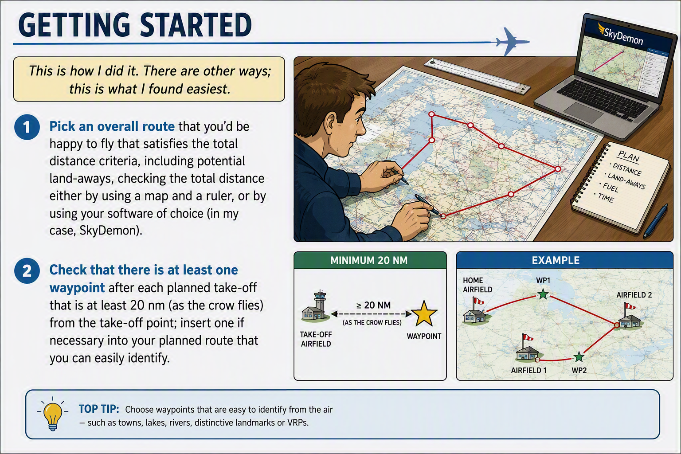
Getting started

Slide 5
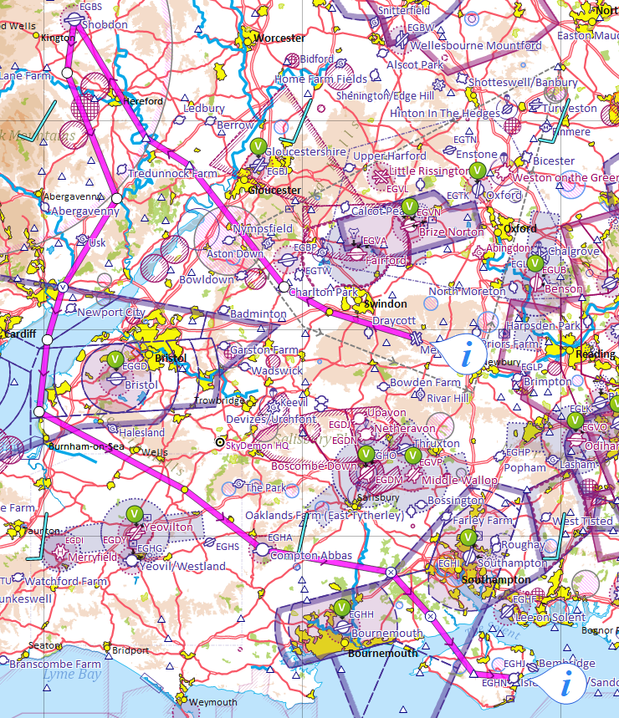
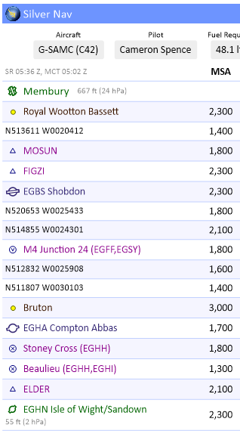
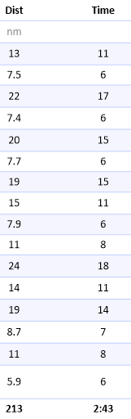
Initial plan, no landings yet

Slide 6
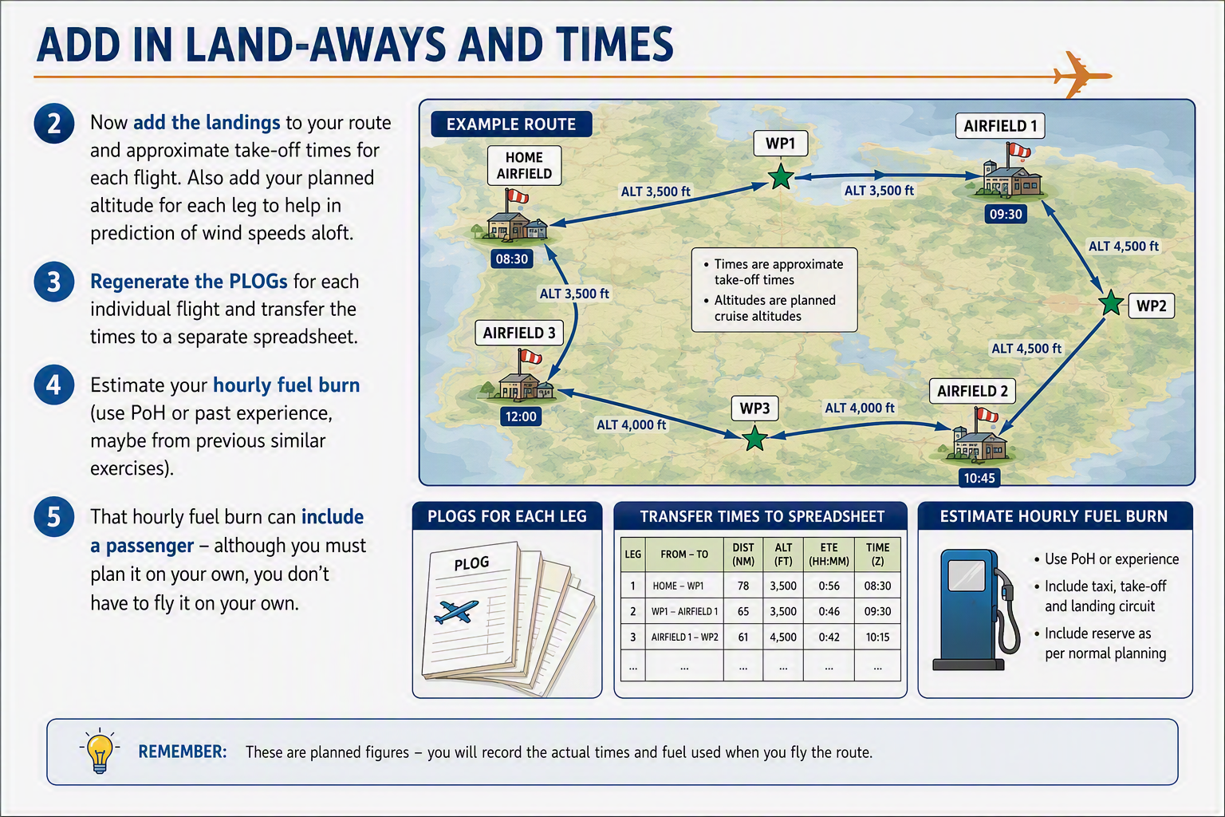
Add in land-aways and times

Slide 7
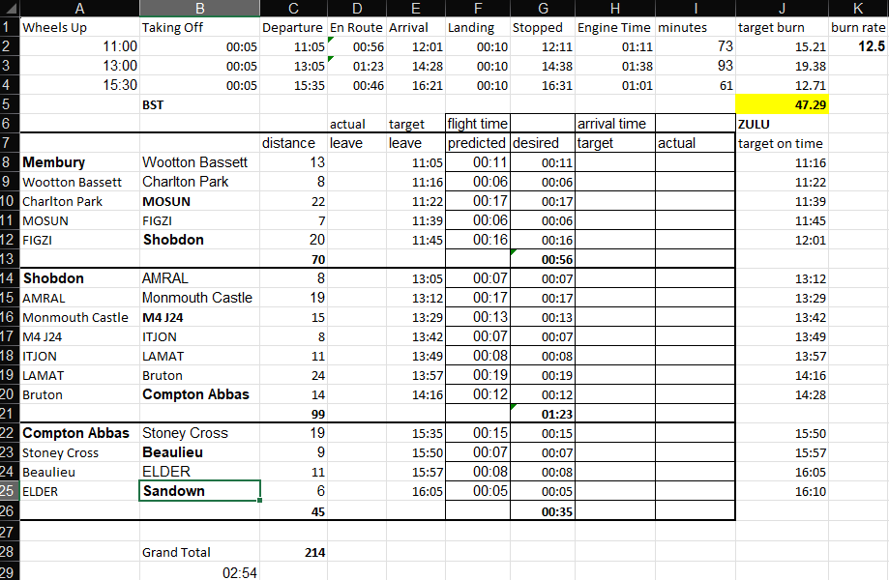
Running the numbers
Specified waypoints highlighted
Distances and times taken straight from the PLOG
You can print this out and fill in as you do the flights

Slide 8
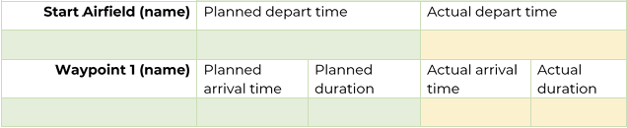
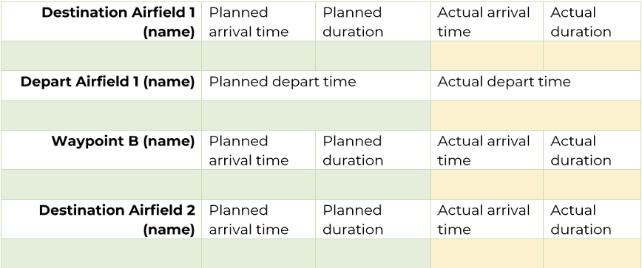
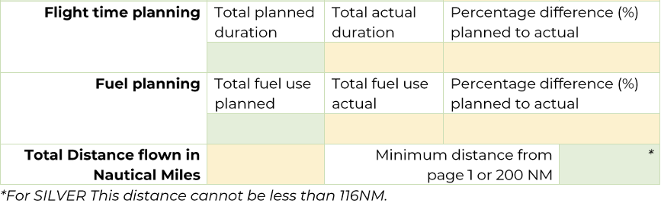
Record the plan
(6) Use the template from the Wings website, fill in the planned times and durations from the spreadsheet (airfields plus the specified waypoint)
(7) Fill in planned total fuel use and total distance
(8) Give to observer or email to wings@bmaa.org

Slide 9
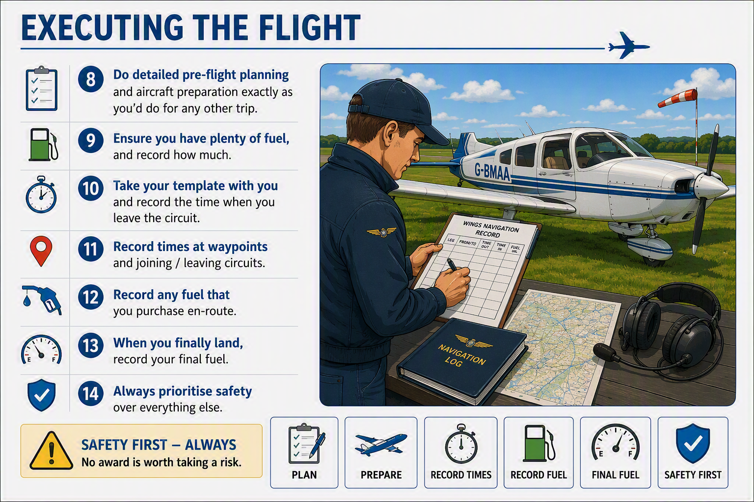
Executing the flight

Slide 10
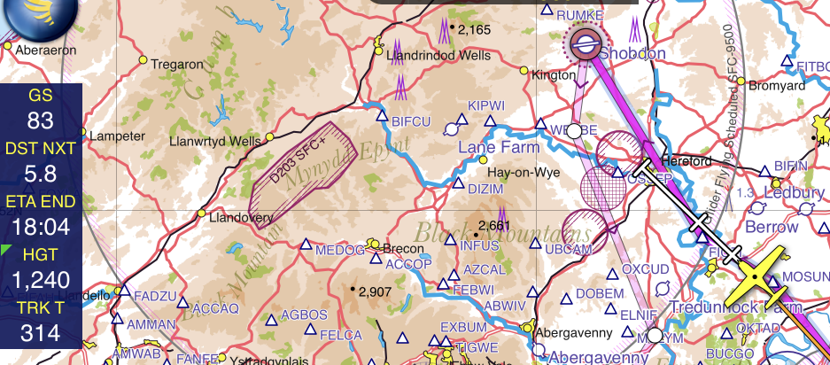
While you’re flying …
Keep an eye on ETA END – adjust airspeed to keep this on target

Slide 11
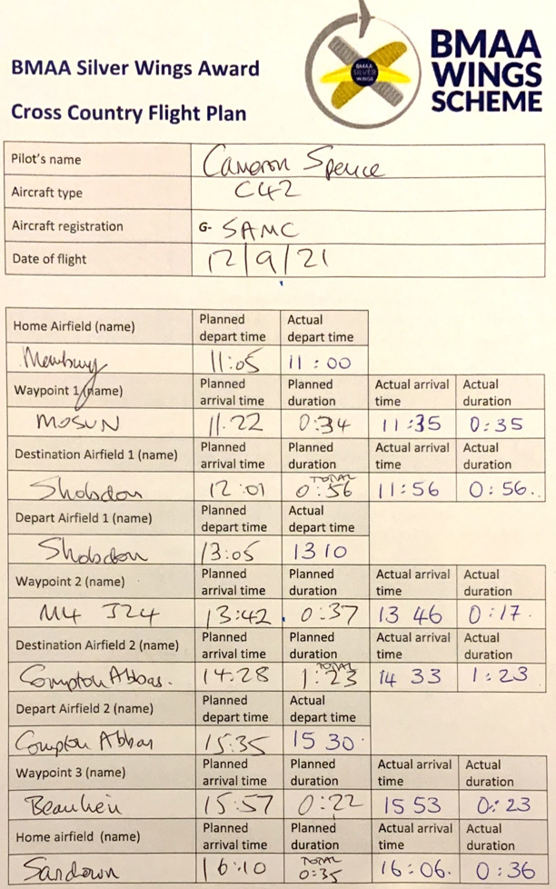
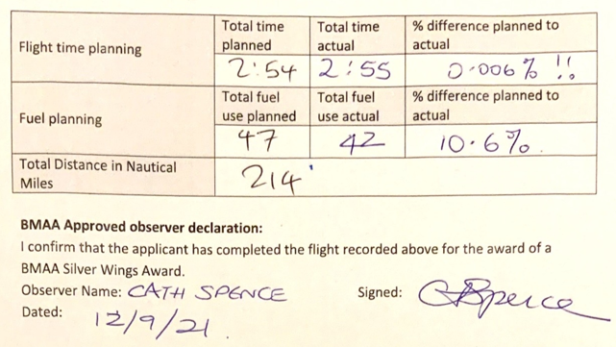

Completed plan vs. actuals
Fuel burn wasn’t as high as I predicted
So next time, reduce the planned burn rate and watch the accuracy increase

Slide 12
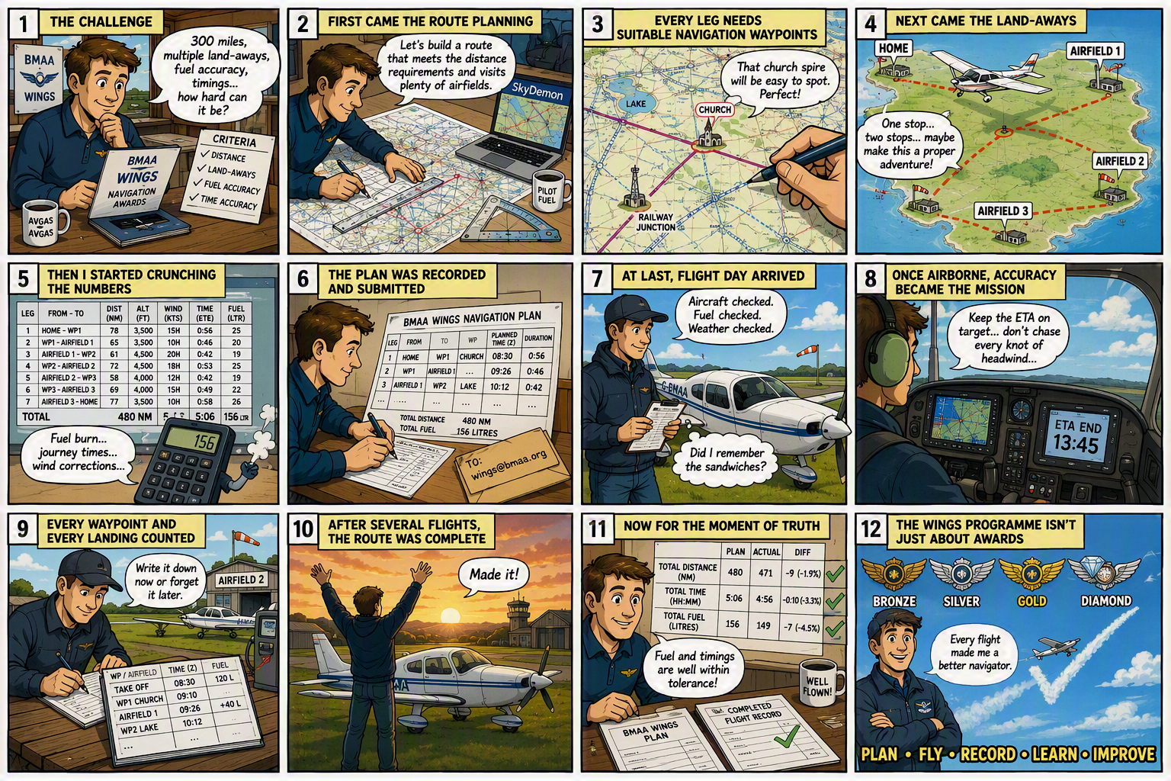
Putting it all together

